Slide 1
Introduction to the Internet
Atul Kahate
akahate@gmail.com
Notes:
1

Slide 2
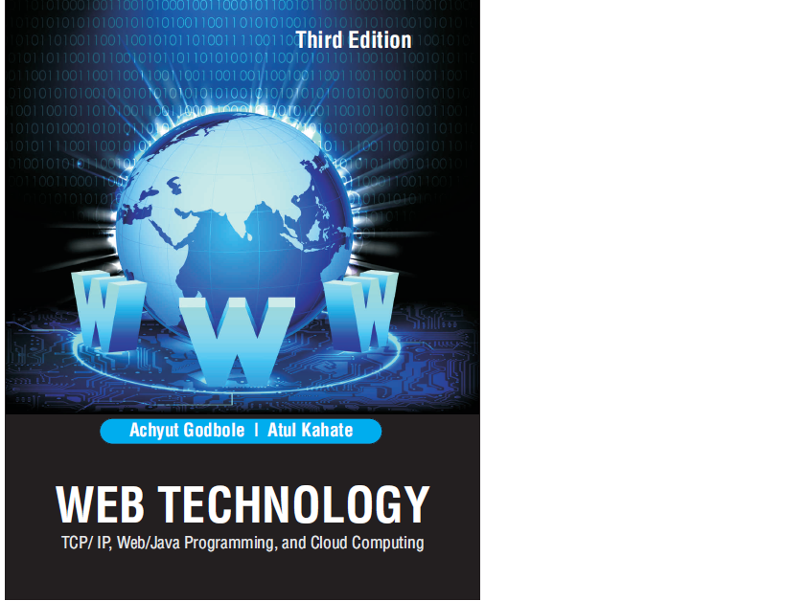
Our Frame of Reference …
An introduction to the Internet | Atul Kahate
2
Notes:
2

Slide 3
Information Encoding
Notes:
3

Slide 4
Representing Symbols
Type
Examples
Total possibilities
Capital letters
A, B through Z
26
Small letters
a, b through z
26
Numbers
0, 1 through 9
10
Special characters
. * , ! @ # $ etc
100 (approx)
Total
162 (approx)
An introduction to the Internet | Atul Kahate
4
Notes:
4

Slide 5
Using Bulbs – Lack of Accuracy
A B C … Z a
# b
*
A B C … Z a
# b
*
A
B
An introduction to the Internet | Atul Kahate
5
Notes:
5

Slide 6
Using Only One Bulb
Off = A
On = B
A B
A B
Bulb State
Input voltage supplied to the bulb
Symbol
Code
Off
0
A
0
On
5
B
1
An introduction to the Internet | Atul Kahate
6
Notes:
6

Slide 7
Using Two Bulbs
Bulb States (First-Second)
Symbol
Code
A B C D
A B C D
A = 00
B = 01
off-off
A
00
off-on
B
01
A B C D
A B C D
on-off
C
10
C = 10
D = 11
on-on
D
11
An introduction to the Internet | Atul Kahate
7
Notes:
7

Slide 8
Using Three Bulbs
State of the first bulb
State of the second bulb
State of the third bulb
Symbol
Code
off
Off
off
A
000
off
Off
on
B
001
off
On
off
C
010
off
on
on
D
011
on
off
off
E
100
on
off
on
F
101
on
on
off
G
110
on
on
on
H
111
An introduction to the Internet | Atul Kahate
8
Notes:
8

Slide 9
A Generic Formula
Number of bulbs
Number of symbols
1
2
2
4
3
8
4
16
5
32
6
64
7
128
8
256
An introduction to the Internet | Atul Kahate
9
Notes:
9

Slide 10
Codification
A Using 8 bulbs off off off off off off off off
Considering off = 0, on = 1 0 0 0 0 0 0 0 0
B Using 8 bulbs off off off off off off off on
Considering off = 0, on = 1 0 0 0 0 0 0 0 1
C Using 8 bulbs off off off off off off on off
Considering off = 0, on = 1 0 0 0 0 0 0 1 0
An introduction to the Internet | Atul Kahate
10
Notes:
10

Slide 11
Communication Protocols
Notes:
11

Slide 12
Layers in Human Communication
IDEAS (World War)
TRANSLATION (English/French)
SESSION MANAGEMENT
MESSAGE (1, 2, 3, … M)
SENTENCES (1, 2, 3, … M)
LINK CONTROL
(Who speaks when)
PHYSICAL (Signals)
IDEAS (World War)
TRANSLATION (English/French)
SESSION MANAGEMENT
MESSAGE (1, 2, 3, … M)
SENTENCES (1, 2, 3, … M)
LINK CONTROL
(Who speaks when)
PHYSICAL (Signals)
An introduction to the Internet | Atul Kahate
12
Notes:
12

Slide 13
A Typical Computer Network
B
C
A
D
G
F
E
An introduction to the Internet | Atul Kahate
13
Notes:
13

Slide 14
OSI Layers
Layer Number
Layer Name
Physical
1 (Lowest)
2
Data Link
3
Network
4
Transport
5
Session
6
Presentation
Application
7 (Highest)
An introduction to the Internet | Atul Kahate
14
Notes:
14

Slide 15
OSI Layers Arranged in a Hierarchy
Application Layer
Presentation Layer
Session Layer
Transport Layer
Network Layer
Data Link Layer
Physical Layer
An introduction to the Internet | Atul Kahate
15
Notes:
15

Slide 16
Data Exchange Using OSI Layers
L7 data
L7 data
L7 data
H6
L7 data
H6
L6 data
H5
L6 data
H5
L5 data
H4
L5 data
H4
L4 data
H3
L4 data
H3
L3 data
H2
L3 data
H2
01010101010001010101001011100000110101
01010101010001010101001011100000110101
Transmission Medium
An introduction to the Internet | Atul Kahate
16
Notes:
16

Slide 17
Physical Layer Between Adjacent Nodes
From Data Link Layer
To Data Link Layer
L3 data H2
L3 data H2
Physical
Layer
Physical
Layer
00110010110
00110010110
Medium
An introduction to the Internet | Atul Kahate
17
Notes:
17

Slide 18
Physical Layer Functions
Coordination of functions required to carry a bit stream over a physical medium (Analog/digital, Serial/parallel)
Deals with mechanical and electrical specifications of the interface and transmission medium
Encoding: Representation of bits into electrical or optical
Data rate: Defines number of bits to be sent in a second (i.e. transmission rate)
Synchronization: Synchronization of the clocks of the sender and the receiver (Synchronous/Asynchronous)
Line configuration: Connection of devices to media (point-to-point or multi-point)
Physical topology: Mesh, star, ring, …
Transmission mode: Simplex, half-duplex, full-duplex
An introduction to the Internet | Atul Kahate
18
Notes:
18

Slide 19
Data Link Layer Between Adjacent Nodes
From Network Layer
To Network Layer
L3 data
L3 data
Data
Frame Link
Layer
Data
Frame Link
Layer
H2
H2
00110010110
00110010110
To Physical Layer
From Physical Layer
An introduction to the Internet | Atul Kahate
19
Notes:
19

Slide 20
Data Link Layer Functions
Responsible for delivery of packets between two hosts connected to the same physical network
Cannot work across networks
Converts the raw physical layer transmission into a reliable link
Framing: Dividing bits into frames
Physical addressing: Adding sender’s and receiver’s physical addresses to the frame header
Flow control: Decide how much data to send at one go
Error control: Add trailer to the frame to take care of damaged, lost, or duplicate frames
Access control: Handle simultaneous transmissions from two or more devices
An introduction to the Internet | Atul Kahate
20
Notes:
20

Slide 21
Hop-to-hop Delivery
Suppose host A wants to send a packet to host G
Communication happens at data link layer one hop at a time
A to SA (Data link layer at A sends a frame to data link layer at SA, etc)
SA to SF
SF to SG
SG to G
Headers in each of these frames differs
A to SA: Sender’s address is A, destination address is SA
SA to SF: Sender’s address is SA, destination address is SF
etc
An introduction to the Internet | Atul Kahate
21
Notes:
21

Slide 22
Data Link Layer in LANs
Logical Link Control (LLC)
Data Link Layer
Media Access Control (MAC)
An introduction to the Internet | Atul Kahate
22
Notes:
22

Slide 23
Network Layer Between Adjacent Nodes
From Transport Layer
To Transport Layer
L4 data
L4 data
Network
Frame Layer
Network Layer
H3
Frame
H3
L3 data
L3 data
To Data Link Layer
From Data Link Layer
An introduction to the Internet | Atul Kahate
23
Notes:
23

Slide 24
Switches in a Network (also called as Routers)
B
C
S_{B}
S_{C}
A
S_{A}
S_{D}
D
S_{F}
S_{G}
S_{E}
G
F
E
An introduction to the Internet | Atul Kahate
24
Notes:
24

Slide 25
Network Layer Functions – 1
Responsible for source-to-destination delivery of packets possibly across different networks (links).
Coordinates delivery of packets from the original sender to the final destination.
In-between, data link layer takes care of hop-by-hop delivery between nodes attached to the same network.
An introduction to the Internet | Atul Kahate
25
Notes:
25

Slide 26
Network Layer Functions – 2
Logical addressing: Physical addresses are defined by data link layer to take care of addressing inside the same network. If a packet has to travel across a network to another network, physical addressing will not work. Hence, a “universal address” or a “logical address” is required. This is done at the network layer. A header is added for this and other purposes.
Routing: When independent networks are connected to form an internetwork (or internet), i.e. a network of networks, the connecting devices (switches or routers) route the packets to the final destination. Network layer is responsible for this function.
An introduction to the Internet | Atul Kahate
26
Notes:
26

Slide 27
Source-to-Destination Delivery
Refer to the same diagram as earlier
Network layer at A sends the packet to the network layer at SA
Network layer at SA forwards the packet to the network layer at SF, and so on
For this, SA uses its routing table to decide how to proceed to the next hop
Will discuss this later
An introduction to the Internet | Atul Kahate
27
Notes:
27

Slide 28
Transport Layer
From Session Layer
To Session Layer
L5 data
L5 data
Transport Layer
Transport Layer
Transport Layer
H4
H4
H4
H4
L4 data
L4 data
L4 data
L4 data
To Network Layer
From Network Layer
An introduction to the Internet | Atul Kahate
28
Notes:
28

Slide 29
Transport Layer Functions – 1
“Process” is an application program running on a host
Network layer delivers packets from source to destination, but has no clue about the relationship between these packets
It treats each one of them as an independent packet
Transport layer takes care of ensuring that the whole message arrives from the sender to the destination
Also handles flow control and error control at the source-to-destination level
An introduction to the Internet | Atul Kahate
29
Notes:
29

Slide 30
Transport Layer Functions – 2
Layer | Responsibility
Data link | Hop-to-hop
Network | Source-to-destination
Transport | Process-to-process
An introduction to the Internet | Atul Kahate
30
Notes:
30

Slide 31
Transport Layer Functions – 3
Port addressing: Ensure the right application gets packets on a computer running several applications
Segmentation and reassembly: Divide a message into segments, each bearing a segment number
Destination uses these to reassemble messages and to track loss, duplication, or sequencing problems
Connection control: Connection-oriented or connection-less
Flow control: End-to-end, not hop-to-hop
Error control: Process-to-process, not hop-to-hop
Usually uses acknowledgments and retransmissions for this
An introduction to the Internet | Atul Kahate
31
Notes:
31

Slide 32
Session Layer
From Presentation Layer
To Presentation Layer
L6 data
L6 data
Session Layer
Session Layer
H5
H5
Checkpoints
Checkpoints
L5 data
L5 data
To Transport Layer
From Transport Layer
An introduction to the Internet | Atul Kahate
32
Notes:
32

Slide 33
Session Layer Functions
Dialog control: Allows two systems to enter into a dialog (half-duplex or full-duplex)
Synchronization: Adds checkpoints to allow restart from the last checkpoint, instead of having to send the whole data once again from scratch
An introduction to the Internet | Atul Kahate
33
Notes:
33

Slide 34
Presentation Layer
From Application Layer
To Application Layer
L7 data
L7 data
Presentation
Layer
Presentation
Layer
Encoded, encrypted and compressed data
H6
Decoded, decrypted and uncompressed data
H6
Presentation
Layer
L6 data
L6 data
To Session Layer
From Session Layer
An introduction to the Internet | Atul Kahate
34
Notes:
34

Slide 35
Presentation Layer Functions
Translation: Use of a common format to take care of differences (encoding, number representation etc)
Encryption: To achieve confidentiality or privacy
Compression: Reduces the number of bits needed to be transmitted
An introduction to the Internet | Atul Kahate
35
Notes:
35

Slide 36
Application Layer
Application
Layer
Application
Layer
Email
…
WWW
Email
…
WWW
L7 data
L7 data
To Presentation Layer
From Presentation Layer
An introduction to the Internet | Atul Kahate
36
Notes:
36

Slide 37
Application Layer Functions
Provides an “application view” to a network (e.g. email, file transmission)
Network virtual terminal: Allows a host to connect to a remote computer, as if this is a local connection
Creation of software emulation of a terminal at the remote computer
File transfer, access, and management
Mail services
Directory services
An introduction to the Internet | Atul Kahate
37
Notes:
37

Slide 38
Introduction to TCP/IP
Notes:
38

Slide 39
Protocols in the TCP/IP Suite at Different Layers
TELNET
Simple Mail Transfer Protocol (SMTP)
File Transfer Protocol (FTP)
Hyper Text Transfer Protocol (HTTP)
Trivial File Transfer Protocol (TFTP)
Application Layer
Transmission Control Protocol (TCP)
User Datagram Protocol (UDP)
Transport Layer
Internet Control Message Protocol (ICMP)
Internet Protocol (IP)
Address Resolution Protocol (ARP)
Reverse Address Resolution Protocol (RARP)
Network Layer
Network Interface Protocols
Data Link Layer and Physical Layer are combined: TCP/IP does not define these
Physical Networks
An introduction to the Internet | Atul Kahate
39
Notes:
39

Slide 40
Mapping of TCP/IP Protocols With the OSI Model
Application
Applications
SMTP
FTP
DNS
HTTP
TELNET
Presentation
Session
Transport
TCP
UDP
Network
ICMP
IP
ARP
RARP
Data Link
Protocols specific to the underlying physical media used for data communication at the hardware level
Physical
An introduction to the Internet | Atul Kahate
40
Notes:
40

Slide 41
Message Transfer From the Source to the Destination at Different Layers
Source
Destination
Original Message
Original Message
TCP header
Original Message
TCP header
Original Message
IP header
TCP header
Original Message
IP header
TCP header
Original Message
Frame header
IP header
TCP header
Original Message
Frame header
IP header
TCP header
Original Message
An introduction to the Internet | Atul Kahate
41
Notes:
41

Slide 42
Addressing
Notes:
42

Slide 43
Addressing
Four levels of addressing are used in the Internet
Physical (Physical and data link layers)
Logical (Network layer)
Port (Transport layer)
Specific (Application layer)
An introduction to the Internet | Atul Kahate
43
Notes:
43

Slide 44
Physical Addresses – 1
Defined by a LAN or WAN
Has authority within the LAN or WAN
Size and format varies per technology
Example: Ethernet has 48-bit (i.e. 6-byte) physical address, but LocalTalk has 1-byte dynamic address
Example of a physical address in Ethernet is 07:01:01:02:2B:4C
Another (related) factor is that the frame formats themselves are different in different physical networks
An introduction to the Internet | Atul Kahate
44
Notes:
44

Slide 45
Physical Addresses – 2
12
27
54
88
Source address
Destination address does not match – Discard packet
Data
Trailer
Data
88 12 T
88 12 T
Data
Data
Destination address
LAN
An introduction to the Internet | Atul Kahate
45
Notes:
45

Slide 46
Logical Addresses – 1
Necessary for universal communications that are independent of the underlying physical networks
32-bit address currently
Called as IP address
An introduction to the Internet | Atul Kahate
46
Notes:
46

Slide 47
Logical Addresses – 2
S/2
Data
Higher layers
S D
Network layer
Data
2 10 T
S D
Data link layer
Data
LAN-1
P 10
Router R1
82 57 T
S D
Data
Q 39
LAN-2
K 82
39 82 T
S D
Data
Router R2
LAN-3
H 57
57 5 T
S D
57 5 T
Data
S D
Data link layer
Data
S D
Network layer
Data
Data
Higher layers
D/5
An introduction to the Internet | Atul Kahate
47
Notes:
47

Slide 48
Logical Addresses – 3
Each router has multiple physical addresses and multiple logical addresses
Sender knows only the logical address of the receiver, not its physical address
Whenever a frame arrives at a router:
The router opens it to see the destination logical address
Consults its routing tables to see what is the next hop for the destination logical address
Creates a new frame, encapsulating the packet; the physical destination address being the physical address of the next hop
Usually this is the physical address of the next router, unless the next hop is actually the final destination
Logical addresses in the packet never change from the source to the destination, but physical source and destination addresses keep changing at every hop
An introduction to the Internet | Atul Kahate
48
Notes:
48

Slide 49
Port Addresses
IP and physical addresses help packets travel from a source to a destination
The source and destination may be running several applications
The port address identifies which of these source and destination applications is the sender/recipient of these packets
An introduction to the Internet | Atul Kahate
49
Notes:
49

Slide 50
Specific Addresses
User-friendly versions of addresses
Examples
Email: akahate@gmail.com
URL: www.iflexsolutions.com
Get converted into the corresponding IP addresses and port numbers
An introduction to the Internet | Atul Kahate
50
Notes:
50

Slide 51
Internet Layer
Notes:
51

Slide 52
Sample Ethernet
A
B
C
D
E
The Network Interface Card (NIC) Is the Interface Between a Host and the Network to Which It Attaches
www.one.com
IP address: 10.10.10.0
Type: Ethernet
Name: Network 1
NIC
Cable
An introduction to the Internet | Atul Kahate
52
Notes:
52

Slide 53
Different Networks in the Internet
A
Net-1 (Ethernet)
Net-2 (X.25)
Net-3 Token Ring
R1
R2
B
C
D
E
F
G
An introduction to the Internet | Atul Kahate
53
Notes:
53

Slide 54
Different Frame Formats
Preamble
(7 bytes)
Delimiter
(1 byte)
Destination address
(6 bytes)
Source address
(6 bytes)
Length
(2 bytes)
Data
(46-1500 bytes)
CRC
(4 bytes)
(a) Ethernet frame format
General Logical Receive Send Data
Format Channel Number Number (Variable length)
Identifier Identifier (4 bits) (4 bits)
(4 bits) (12 bits)
(b) X.25 frame format
Preamble
(3 bytes)
Destination address
(2-6 bytes)
Source address
(2-6 bytes)
Data
(Up to 1500 bytes)
CRC
(4 bytes)
Delimiter
(2 bytes)
(c) Token Ring frame format
An introduction to the Internet | Atul Kahate
54
Notes:
54

Slide 55
A Router Has Two or More IP Addresses
231.200.117.19
Token Ring 231.200.117.0
Ethernet 130.100.17.0
R1
130.100.17.7
WAN
87.12.0.0
87.12.0.23
R2
231.200.117.41
An introduction to the Internet | Atul Kahate
55
Notes:
55

Slide 56
Address Mapping
Notes:
56

Slide 57
Types of Mapping
Address mapping can be:
Static (e.g. Address Resolution Protocol – ARP)
Fixed, and is stored on all hosts in a network
Problems
If we change the NIC of a computer, its physical address changes
In some protocols, the physical address is ever-changing
Mobile computers can move across physical networks
Dynamic (e.g. DHCP)
A host knows one of the addresses (logical or physical), and can find the other at run time
An introduction to the Internet | Atul Kahate
57
Notes:
57

Slide 58
Address Resolution Protocol (ARP)
Notes:
58

Slide 59
Address Resolution Protocol (ARP)
IP
address
Input
Address Resolution Protocol
(ARP)
Physical address
Output
An introduction to the Internet | Atul Kahate
59
Notes:
59

Slide 60
Example of ARP
a) A router or a host sends an ARP query datagram.
(b) Only the concerned host replies back and also sends its physical address
ARP query datagram
Hi! I am looking for a node whose IP address is 120.91.10.157.
Here you go! I am the one whose IP address is 120.91.10.157. My physical address is A71FG1415TA
ARP response
An introduction to the Internet | Atul Kahate
60
Notes:
60

Slide 61
ARP Packet Format
8 bits 8 bits 16 bits
Hardware type (e.g. Ethernet = 1)
Protocol type (e.g. IP = Hex 0800)
Hardware length (e.g. 6 for Ethernet)
Protocol length (e.g. 4 for IP Version 4)
Operation (Request = 1, Reply = 2)
Sender’s physical address
Sender’s IP address
Receiver’s physical address (Empty in a Request message)
Receiver’s IP address
An introduction to the Internet | Atul Kahate
61
Notes:
61

Slide 62
Encapsulation
An ARP packet is encapsulated inside a data link layer frame (e.g. Ethernet)
The frame type indicates that this frame contains an ARP packet
Preamble
SFD
Destination address
Source address
Type
Data
CRC
7 bytes
1 byte
6 bytes
6 bytes
2 bytes
ARP request or response
4 bytes
Contains Hex 0806 for ARP
An introduction to the Internet | Atul Kahate
62
Notes:
62

Slide 63
Operation
Sender knows the target IP address.
IP asks ARP to create an ARP request message. It fills the sender’s physical address, the sender’s IP address, and the target IP address. The target physical address is filled with all zeroes.
This message is given to the data link layer. It is encapsulated inside a data link layer frame. The source address is the sender’s physical address, and the physical broadcast address as the destination address.
Every host or router attached to the network receiver the frame. All of them remove the frame header and pass it to the ARP module. All hosts/routers except the actual target drop the packet. The target recognizes its IP address.
The target responds with an ARP reply message, filling its physical address in the ARP packet. It sends it only to the original sender. That is, this is not broadcasted.
The sender now knows the physical address of the target, and hence can communicate with it. For this, it creates an IP datagram, encapsulates it inside a data link layer frame, and sends it to he target.
An introduction to the Internet | Atul Kahate
63
Notes:
63

Slide 64
ARP Example
IP address = 129.26.44.21
Physical address = 0xB43126931010
IP address = 129.26.44.10
Physical address = 0xA57BAB1223C1
0x0001
0x0800
0x06
0x04
0x0001
0xB43126931010
129.26.44.21
0x000000000000
129.26.44.10
ARP Request
0x0001
0x0800
0x06
0x04
0x0002
0xA57BAB1223C1
129.26.44.10
0xB43126931010
129.26.44.21
ARP Response
Time
An introduction to the Internet | Atul Kahate
Time
64
Notes:
64

Slide 65
RARP, BOOTP, and DHCP
Notes:
65

Slide 66
Mapping Physical to Logical Addresses: RARP, BOOTP, and DHCP
A host may know its physical address, and may want to find out its IP address
A diskless workstation boots. Its physical address is on the NIC, but the IP address is unknown.
An organization is short on IP addresses. It asks stations to send requests for IP addresses, and serves them on demand.
People can move from one office to another and want to seamlessly connect to the corporate network and to the Internet while on the move
An introduction to the Internet | Atul Kahate
66
Notes:
66

Slide 67
Reverse Address Resolution Protocol (RARP)
Notes:
67

Slide 68
Reverse Address Resolution Protocol (RARP) – 1
The IP address of a host is usually stored in some configuration file on its disk
The host uses this IP address to communicate with the rest of the computers
However, a diskless workstation only has ROM; and it does not contain the IP address, because the IP address is assigned by the local system administrator
An introduction to the Internet | Atul Kahate
68
Notes:
68

Slide 69
Reverse Address Resolution Protocol (RARP) – 2
The host needing to know its IP address broadcasts an RARP request, containing its physical address
Another host that knows the IP addresses of all the hosts on the network responds with the IP address
Problem: Broadcasting is at data link layer
The physical broadcast address (all ones in Ethernet) does not cross boundaries of a network (e.g. if subnets are created)
Hence, RARP is obsolete
An introduction to the Internet | Atul Kahate
69
Notes:
69

Slide 70
Bootstrap Protocol (BOOTP)
Notes:
70

Slide 71
BOOTP Versus RARP
RARP limitations
Operates as a low-level broadcast protocol
Requires adjustments for various hardware types
RARP server needs to be configured on every network
Provides for only IP address, and nothing else
BOOTP
Uses UDP, and is hence independent of hardware
Supports additional configuration information to be sent to the client, in addition to its IP address
Client and server can be on different networks, thus supports internetworking
An introduction to the Internet | Atul Kahate
71
Notes:
71

Slide 72
BOOTP Operation
BOOTP server maintains mapping between IP and physical addresses
Client sends a request with its physical address, asking for IP address
Server looks up physical address of the client in its tables, and returns IP address
A special well-known port (67) is used for BOOTP UDP requests
An introduction to the Internet | Atul Kahate
72
Notes:
72

Slide 73
How BOOTP Works?
Application layer client/server protocol; client and server can be remote
BOOTP messages are encapsulated inside UDP datagrams, which are encapsulated inside IP datagrams
Client does not know its and the server’s IP address
Puts all 0s as source IP address and all 1s as destination IP address
Problem: Request is broadcasted, and hence cannot pass routers. Hence, one host/router is configured as a relay agent. It knows the unicast address of a BOOTP server, and passes the packet to it.
See next slide
An introduction to the Internet | Atul Kahate
73
Notes:
73

Slide 74
Need for Relay Agents
BOOTP is designed to allow the BOOTP server and clients to be on different networks
This centralizes the BOOTP server and greatly reduces the amount of work for system administrators
However, this means the protocol is more complex
Why? RARP works at data link layer, so cannot allow clients and server to be on different physical networks
The whole point about BOOTP is to allow use of IP, and if IP is used, we should be able to send packets from one network to another arbitrarily!
True, but BOOTP (like RARP) uses broadcasting
Client does not know the address of a BOOTP server, and hence sends a broadcast request
For efficiency reasons, routers do not route broadcasts – this clogs the network
Hence, if client and server are on different networks, server cannot hear client’s broadcast
Hence, we need a Relay Agent
An introduction to the Internet | Atul Kahate
74
Notes:
74

Slide 75
Function of BOOTP Relay Agent
Sits on a physical network where BOOTP clients may be located and acts as a proxy for the BOOTP server
Relays messages between a client and a server, and hence called as Relay Agent
Usually implemented in software on an existing router – dual role
An introduction to the Internet | Atul Kahate
75
Notes:
75

Slide 76
BOOTP Operation Using a Relay Agent
Client creates a BOOTP request and broadcasts it to address 255.255.255.255.
Relay agent on the client’s physical network is listening on UDP port 67 on the server’s behalf.
Relay agent sends the BOOTP request to BOOTP server.
If the Relay Agent knows the address of the BOOTP server, it would be a unicast transmission.
Otherwise the Relay Agent broadcasts the BOOTP requests on the other interface to which it connects.
Server receives the request and creates a BOOTP reply message.
Server sends the BOOTP reply to Relay Agent.
Relay agent sends the response to the original client as unicast or broadcast.
An introduction to the Internet | Atul Kahate
76
Notes:
76

Slide 77
BOOTP Limitations
Lack of support for dynamic addresses
Led to the development of DHCP
An introduction to the Internet | Atul Kahate
77
Notes:
77

Slide 78
Dynamic Host Configuration Protocol (DHCP)
Notes:
78

Slide 79
Dynamic Configuration Protocol (DHCP)
Unlike BOOTP, which considers a mapping table, DHCP can also allocate IP addresses dynamically
Useful when hosts move etc
Static allocation: Can work in the static mode like BOOTP – Done manually
Dynamic allocation: Maintains another table of “available” IP addresses, from which one can be assigned – Done automatically
Normally, a DHCP server would check the static database to see if it finds a match on the host so as to return the static address; if not it returns the dynamic address
An introduction to the Internet | Atul Kahate
79
Notes:
79

Slide 80
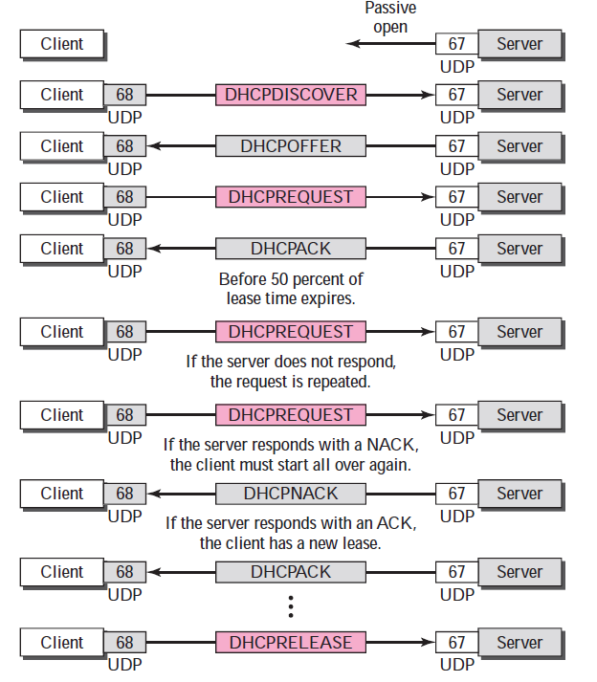
DHCP Messages
An introduction to the Internet | Atul Kahate
80
Notes:
80

Slide 81
DHCP Operation – 1/2
Client creates DHCPDISCOVER message.
It fills its own hardware address in the CHAddr field and uses a random transaction ID (XID).
Client broadcasts the DHCPDISCOVER message.
Each DHCP server on the local network receives this message. It tries to locate the client’s physical address in its mapping tables, and free IP addresses etc.
Servers create DHCPOFFER messages, containing:
The IP address to be assigned to the client in the YIAddr field.
The time for which this IP address is being assigned, etc.
The same transaction ID (XID).
Servers ensure that the same IP address is not in use by sending an ICMP ECHO message (and not getting a response).
Servers send the DHCPOFFER messages (unicast/broadcast).
Client receives and processes DHCPOFFER messages. Client can decide which one to accept.
An introduction to the Internet | Atul Kahate
81
Notes:
81

Slide 82
DHCP Operation – 2/2
Client creates DHCPREQUEST message for the selected server. The message contains:
The identifier of the server to indicate which one is chosen.
The IP address that the server had assigned to this client.
Client broadcasts DHCPREQUEST message.
Servers receive and process the DHCPREQUEST message. Servers not selected will simply ignore this message.
Selected server sends back DHCPACK or DHCPNAK message to indicate whether the offered IP address is still available.
Client receives and processes DHCPACK or DHCPNAK message received from the server.
Client checks whether the IP address is in use, by sending an ARP request packet.
Client finalizes the allocation.
An introduction to the Internet | Atul Kahate
82
Notes:
82

Slide 83
IP Addressing
Notes:
83

Slide 84
IP Address Format
Class Network number Host number
An introduction to the Internet | Atul Kahate
84
Notes:
84

Slide 85
Classes of IP Address
Class A
Class B
Class C
Class D
Class E
Byte 1
Byte 2
Byte 3
Byte 4
0 Network number Host number
1 0 Network number Host number
1 1 0 Network number Host number
1 1 1 0 Multicast address
1 1 1 1 0 Reserved for future use
An introduction to the Internet | Atul Kahate
85
Notes:
85

Slide 86
IP Addresses Allocation to Classes
An introduction to the Internet | Atul Kahate
86
Notes:
86

Slide 87
Exercise
How many addresses can each of the classes have?
An introduction to the Internet | Atul Kahate
87
Notes:
87

Slide 88
Addresses Per Class
Class | Number of Addresses | Percentage
A | 20 Lakh | 50%
B | 10 Lakh | 25%
C | 5 Lakh | 12.5%
D | 2.5 Lakh | 6.25%
E | 2.5 Lakh | 6.25%
An introduction to the Internet | Atul Kahate
88
Notes:
88

Slide 89
Exercise
Find the class of the following addresses
227.12.14.87
193.14.56.22
14.23.120.8
252.5.15.111
134.11.78.56
An introduction to the Internet | Atul Kahate
89
Notes:
89

Slide 90
Determining Class Based on an IP Address
Class | Contents of First Byte (Last three are not shown)
A | 0 to 127
B | 128 to 191
C | 192 to 223
D | 224 to 239
E | 240 to 255
An introduction to the Internet | Atul Kahate
90
Notes:
90

Slide 91
Determining Class
First bit = 0?
Yes
Class A address
No
Second bit = 0?
Yes
Class B address
No
Third bit = 0?
Yes
Class C address
No
Fourth bit = 0?
Yes
Class D address
No
Class E address
An introduction to the Internet | Atul Kahate
91
Notes:
91

Slide 92
Masking
Given the IP address of a host, can we find its network address?
“Masking” concept: AND the complete IP address with a “Mask”, result is the network address
An introduction to the Internet | Atul Kahate
92
Notes:
92

Slide 93
Masking concept
If IP address is 134.45.78.2, network ID is 134.45
An address in the block
AND
Network portion of the IP address
Mask
An introduction to the Internet | Atul Kahate
93
Notes:
93

Slide 94
Masking Example
If IP address is 134.45.78.2, network ID is 134.45 (See next slide)
134.45.78.2
AND
134.45
255.255.0.0
An introduction to the Internet | Atul Kahate
94
Notes:
94

Slide 95
Calculation
The address whose network ID we want
134.45.78.2
Default mask for class B (since the address above is from class B)
AND
255.255.0.0
Network ID for the address
134.45.0.0

Slide 96
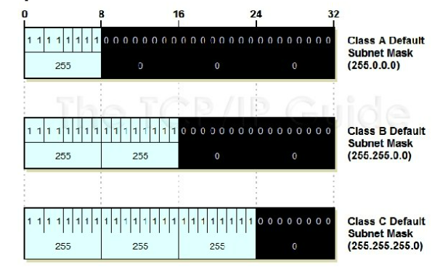
Default Mask

Slide 97
Default Masks
Class | Mask in Binary | Mask in dotted-decimal
A | 11111111 00000000 00000000 00000000 | 255.0.0.0
B | 11111111 11111111 00000000 00000000 | 255.255.0.0
C | 11111111 11111111 11111111 00000000 | 255.255.255.0
An introduction to the Internet | Atul Kahate
97
Notes:
97

Slide 98
Masking Examples
Given an IP address of 23.56.7.91, find the network address.
Given an IP address of 132.6.17.85, find the network address.
An introduction to the Internet | Atul Kahate
98
Notes:
98

Slide 99
Subnetting
Notes:
99

Slide 100
Subnet Concept
Network id
Host id
Two ways to address a particular house
Building number, House number (Normal IP address)
Building number, Floor number, House number (IP address with subnet)
Subnet id
Network id
Host id
An introduction to the Internet | Atul Kahate
100
Notes:
100

Slide 101
Subnetting
Divide a network into smaller sub-networks with each subnet having its own IP address
Allow a network to be split into several internal sub-networks, but act like a single network to the outside world
Motivation: Make better use of the IP address space
IP addresses: Two levels of hierarchy; subnetting makes it three
An introduction to the Internet | Atul Kahate
101
Notes:
101

Slide 102
Subnet Concept
Instead of having just hosts, a network now has subnets and hosts
Each subnet is a subnetwork, and functions like a full-fledged network
Now, networks contain subnets, and each subnet contains hosts
Allows each organization to create its own internetwork within the Internet
An introduction to the Internet | Atul Kahate
102
Notes:
102

Slide 103
Subnetting Example – 1
Consider a class B network 154.71.0.0
16 bits for network part 154.71
16 bits for host ID (hence 65,534* hosts are possible)
*Note: minimum and maximum addresses are reserved for loopback and broadcasting, respectively
We can decide how many bits out of 16 available bits to be used for subnet mask: Consider how many sub nets are likely in near future with how many hosts per sub networks
1 bit for subnet mask, 15 bits for host ID (up to 2 sub networks are possible)
2 bits for subnet mask, 14 bits for host ID (up to 4 sub networks are possible)
Etc
Suppose we decide on 5 bits for subnet mask (32 sub networks are possible)
An introduction to the Internet | Atul Kahate
103
Notes:
103

Slide 104
Subnetting Example – 2
0
8
16
24
32
154
71
Host ID (16-bit)
154
71
Subnet ID (5-bit)
Host ID (11-bit)
Class B network address is 154.71.0.0. The 16-bit host ID is split into 5-bit subnet ID and 11-bit host ID.
An introduction to the Internet | Atul Kahate
104
Notes:
104

Slide 105
Subnetting Example – 3
0
8
16
24
32
154
71
Subnet ID (5 bits)
Host ID (11 bits)
Subnetted Class B network 154.71.0.0
11111111
11111111
11111
000
00000000
1 inserted for each network ID bit and subnet ID bit, 0 for each host ID bit
255
255
248
0
Binary subnet mask converted into decimal format
An introduction to the Internet | Atul Kahate
105
Notes:
105

Slide 106
Explanation of the Diagram
A subnet mask is a 32-bit number
To compute subnet mask:
Determine default mask appropriate for that class (e.g. for class B, default subnet mask is 255.255.0.0, or 11111111 11111111 00000000 00000000).
Change leftmost zeroes to ones for subnet bits. For example, if we use 5 bits for subnet ID, the custom subnet mask looks as 11111111 11111111 11111000 00000000)
Covert it into decimal i.e. 255.255.248.0.
We can also express the subnet mask with a slash notation, e.g. 255.255.248.0/21. This is because there are 21 1s followed by remaining 11 0s.
An introduction to the Internet | Atul Kahate
106
Notes:
106

Slide 107
Subnetting: Practical Guide

Slide 108
Step 1: Requirements Analysis – Find answers to these questions
What class is our IP address block?
How many physical subnets are on the network today? (A “physical subnet” generally refers to a broadcast domain on a LAN; a set of hosts on a physical network bounded by routers.)
Do we anticipate adding any more physical networks in the near future, and if so, how many?
How many hosts do we have in the largest of our subnets today?
How many hosts do we anticipate having in the largest subnet in the near future?

Slide 109
Step 2: Requirements Analysis – Find answers to these questions
Now we should know the two critical parameters: The number of subnets required for the network, and The maximum number of hosts per subnetwork. Now we need to divide the 8, 16 or 24 bits in the “classful” host ID into subnet ID and host ID.
How many bits to “steal” from the host ID to use for the subnet ID?
Each bit taken from the host ID for the subnet ID doubles the number of subnets that are possible in the network.
Each bit taken from the host ID for the subnet ID (approximately) halves the number of hosts that are possible within each subnet on the network.
There are six possible ways this decision can be made for a Class C network (see figure on the next slide).

Slide 110
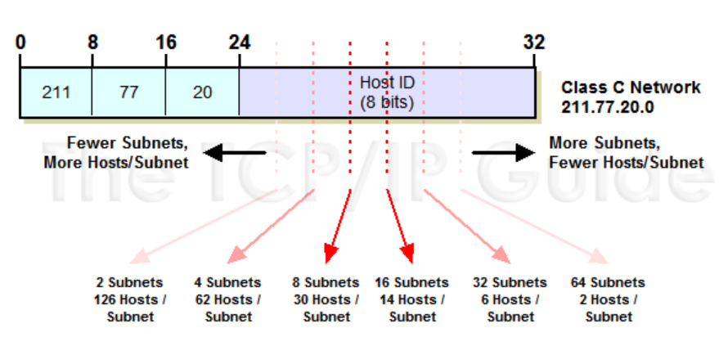
Choices for a class C network

Slide 111
Important points
The relationship between the bits and the number of subnets and hosts is as follows:
The number of subnets allowed in the network is two to the power of the number of subnet ID bits.
The number of hosts allowed per subnet is two to the power of the number of host ID bits, less two.
Now, to choose how many bits to use for the subnet we could use trial and error. That is, we could try to first calculate the number of subnets and hosts when we use one bit for the subnet ID and leave the rest for the host ID. We could then try with two bits for the subnet ID, and then try with three and so on.
This would be time consuming. There's an easier method: we can use the subnetting summary tables.

Slide 112
Step 3: Determining the custom subnet mask (Diagram follows)
Determine Default Subnet Mask: Each of Classes A, B and C has a default subnet mask, which is the subnet mask for the network prior to subnetting. It has a 1 for each network ID bit and a 0 for each host ID bit. For Class C, the subnet mask is 255.255.255.0. In binary, this is:
11111111 11111111 11111111 00000000
Change Left-Most Zeroes To Ones For Subnet Bits: We have decided to use 3 bits for the subnet ID. The subnet mask has to have a 1 for each of the network ID or subnet ID bits. The network ID bits are already 1 from the default subnet mask, so, we change the 3 left-most 0 bits in the default subnet mask from a 0 to 1, shown highlighted below. This results in the following custom subnet mask for our network:
11111111 11111111 11111111 11100000
Convert Subnet Mask To Dotted Decimal Notation: We take each of the octets in the subnet mask and convert it to decimal. The result is our custom subnet mask in the form we usually see it: 255.255.255.224.
Express Subnet Mask In “Slash Notation”: Alternately, we can express the subnet mask in “slash notation”. This is just a slash followed by the number of ones in the subnet mask. 255.255.255.224 is equivalent to “/27”.

Slide 113
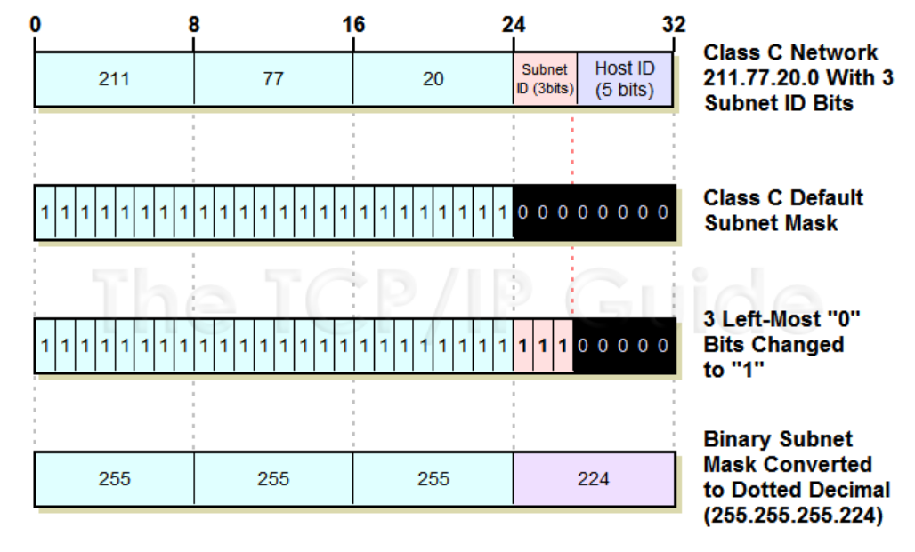
Step 3: Determining the custom subnet mask

Slide 114
Step 4: Determining subnet identifiers and addresses
The network ID assigned to our network applies to the entire network. This includes all subnets and all hosts in all subnets. Each subnet, however, needs to be identified with a unique subnet identifier or subnet ID, so it can be differentiated from the other subnets in the network. This is of course the purpose of the subnet ID bits that we took from the host ID bits in subnetting. After we have identified each subnet we need to determine the address of each subnet, so we can use this in assigning hosts specific IP addresses.
We determine the subnet IDs and addresses as follows
Subnet ID: This is just the subnet number, and can be expressed in either binary or decimal form.
Subnet Address: This is the address formed by taking the address of the network as a whole, and substituting the (binary) subnet ID in for the subnet ID bits. We need to do this in binary, but only for the octets where there are subnet ID bits; the ones where there are only network ID bits or only host ID bits are left alone.
Seem complicated? Let's go back to our examples and we’ll see that it’s really not.

Slide 115
Step 5: Determining host addresses for each subnet
Once we know the addresses of each of the subnets in our network, we use these addresses as the basis for assigning IP addresses to the individual hosts in each subnet. We start by associating a subnet base address with each physical network. We then sequentially assign hosts particular IP addresses within the subnet.
Determining host addresses is really quite simple, once we know the subnet address. All we do is substitute the numbers 1, 2, 3… and so on for the host ID bits in the subnet address. We must do this in binary of course, and then convert the address to decimal form.

Slide 116
Step 5: Determining host addresses for each subnet
Let's start with our Class C example again, 211.77.20.0, which we divided into 8 subnets using 3 subnet bits. Here's how the address appears with the subnet bits shown highlighted, and the host ID bits shown highlighted and underlined.:
11010011 01001101 00010100 00000000

Slide 117
Step 5: Determining host addresses for each subnet
For subnet 1, host 1, the address will be:
11010011 01001101 00010100 00000001
211. 77. 20. 1
For subnet 1, host 2, the address will be:
11010011 01001101 00010100 00000010
211. 77. 20. 2
For subnet 1, last host, the address will be:
11010011 01001101 00010100 00011110
211. 77. 20. 30

Slide 118
Step 5: Determining host addresses for each subnet
For subnet 2, host 1, the address will be:
11010011 01001101 00010100 00100001
211. 77. 20. 33
For subnet 2, host 2, the address will be:
11010011 01001101 00010100 00100010
211. 77. 20. 34
For subnet 2, last host, the address will be:
11010011 01001101 00010100 00111110
211. 77. 20. 62

Slide 119
Step 5: Determining host addresses for each subnet
We can do the same thing for each of the other subnets; the only thing that changes is the values in the subnet ID bits. Let's take for example, subnet #6. It has “110” for the subnet bits instead of “000”. So, its subnet base address is 211.77.20.192, or:
11010011 01001101 00010100 11000000
We assign hosts to this subnet by substituting 00001, then 00010, then 00011 for the host ID bits as before:
The first host address is:
11010011 01001101 00010100 11000001
Or 211.77.20.193.
The second host address is:
11010011 01001101 00010100 11000010
Or 211.77.20.194.
And so on, all the way up to the last host in the subnet, which is 211.77.20.222.

Slide 120
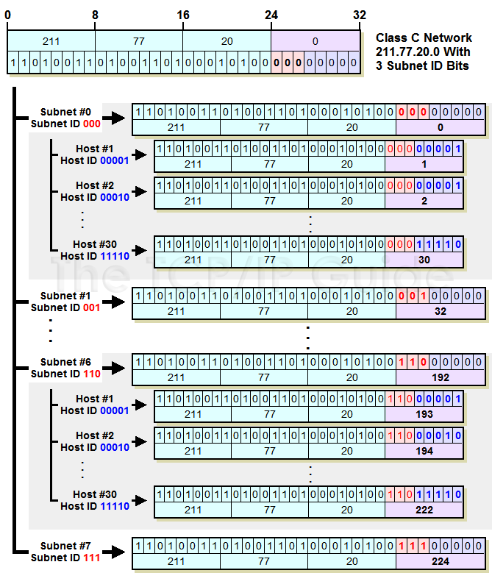
Determining host addresses for a class C address
There is a mistake here. It should be 10

Slide 121
Interesting technique: The host’s formula
The host's formula will tell you how many hosts will be allowed on a network that has a certain subnet mask.
The host's formula is 2^{h} - 2.
Here, h represents the number of 0s in the subnet mask, if the subnet mask were converted to binary.
The first and last addresses are reserved: the first to identify the network and the last to be used as the broadcast address.

Slide 122
Step 1: Find the host range
Suppose you plan to use the IP address space 192.168.0.0. Currently, you have a small network subnet with 20 hosts. This network will grow to 300 hosts within the next year, however, and you plan to have multiple locations of a similar size in the future and need to enable them to communicate using this address space.
With a single network subnet and only 20 hosts, the simplest thing to do would be to use 255.255.255.0 as your subnet mask. This would mean you would have 192.168.0.1 through 192.168.0.254 for your hosts. The address 192.168.0.0 is reserved as the network subnet identifier, and 192.168.0.255 is reserved for the network broadcast address.

Slide 123
Step 2: Convert to binary
Before you decide to use this subnet mask, however, let's apply the host's formula to it. To use the host's formula in this scenario, you take the subnet mask 255.255.255.0 and convert it to binary. This would give you: 111111111 11111111 11111111 00000000.
As you can see, there are eight 0s in the subnet mask. To use this with the host's formula, you would calculate 2⁸ - 2. This comes to 256 minus the 2 reserved addresses, or 254. So, with the subnet mask specified, you will get 254 usable hosts.
This would suit your 20-user network now but won't support your future network expansion to 300 hosts.

Slide 124
Step 3: Calculate the total number of hosts per subnet
You should plan ahead and choose the best subnet mask the first time. This prevents you from having to go back later and change all the IP addresses on this network. Adding 1s to the subnet mask means you get fewer hosts per network subnet but more network subnets. If you remove 1s from the subnet mask, you get more hosts per network but fewer networks. The latter is what we need to do.
To do this, let's take away one of the 1s to make our subnet mask:
11111111 11111111 11111110 0000000
In decimal number, or dotted quad representation, this is 255.255.254.0.
This means you have nine 0s in the host portion of the subnet mask. To apply the host's formula with this subnet mask, we'd calculate 2⁹ - 2. The number of usable host IP addresses is 512 minus 2, or 510. This would definitely suit a 20-user network now and future network and host expectations of 300 hosts.
Considering that information, we know the most efficient subnet mask for the network is 255.255.254.0. The valid host address range for each subnet must be written as two ranges, due to the limitations of writing the addresses as dotted quads. The first IP subnet would be 192.168.0.1 through 192.168.0.255 and 192.168.1.0 through 192.168.1.254. Note that 192.168.0.0 identifies the subnet, and 192.168.1.255 is the network broadcast address.
That is how you arrive at the total of 510 usable hosts.

Slide 125
Step 4: Calculate the number of subnets
Now that you understand the host's formula, you should also know the subnet's formula, which will ensure you have the right subnet mask for the number of subnets that you have. Just because you determine you have the right number of hosts for your LAN using the host's formula doesn't mean you'll have enough subnets for your network. Let's see how the subnet's formula works.
The subnet's formula is 2s, where s is the number of 1s added to the subnet mask, from whatever the subnet mask was. Let's take the same example as above, but build on it.
Using network 192.168.0.0, we expect to have 100 remote sites with 300 PCs each. What subnet mask should we use? In our last example, we found the 255.255.254.0 subnet mask provided 510 hosts per subnet. That was more than adequate to support 300 PCs, but does that same subnet mask provide networks for at least 100 remote sites? Let's find out.

Slide 126
Step 5: Verify the total number of subnets
The number of subnets is found by counting the number of bits by which the initial mask was extended, also known as the subnet bits. Our initial address allocation was 192.168.0.0 with a mask of 255.255.0.0. Using the host's formula, we selected a subnet mask of 255.255.254.0. Let's compare the two masks and count the subnet bits.
Let's convert to binary:
255.255.0.0 = 11111111 11111111 00000000 00000000
255.255.254.0 = 11111111 11111111 11111110 00000000
The new mask uses seven subnet bits. Using the subnet's formula, this would give us 2⁷ = 128 networks. This is at least 100, so we have enough subnets for 100 remote networks. This means we have found the right subnet mask for our network. We convert our subnet mask from binary back to decimal and get 255.255.254.0.
As you add subnet bits, the number of subnets increases by a factor of two, and the number of hosts per subnet decreases by a factor of two. The table below shows the number of subnets and hosts for each of eight mask bits in the third octet of an IPv4 address.

Slide 127
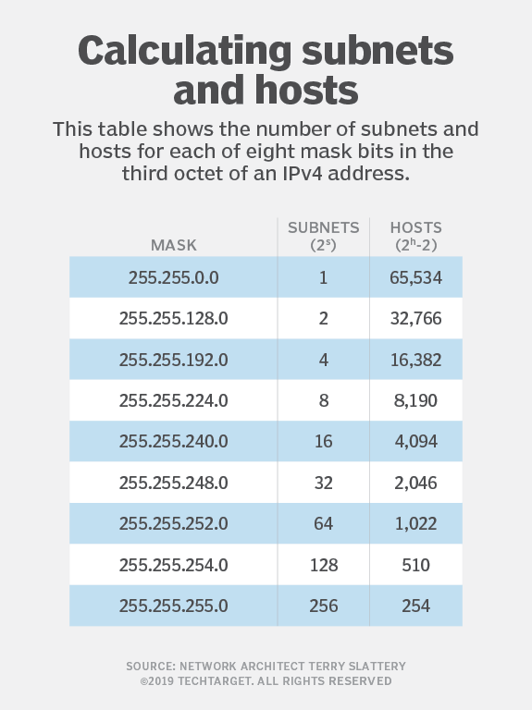
Useful table

Slide 128
Subnetting Exercise – 1
A host has the IP address 198.22.45.173. What is the network address of which the host is a member?
Solution: 198.22.45.173 is a class C address. Let us write it in binary and do a AND with the default mask for class C address:
Network address is 198.22.45.0
198.22.45.173
AND 255.255.255.0
Result 198.22.45.0

Slide 129
Subnetting Exercise – 2
For an address 192.168.5.85 /24, find the network and host parts of the address.
Solution:
This is a class C address (subnet mask 255.255.255.0)
Doing a (actually binary) AND:
Network address is 192.168.5.0. Host addresses will be from 192.168.5.1 to 192.168.5.254. Broadcast address will be 192.168.5.255.
192.168.5.85
AND 255.255.255.0
Result 192.168.5.0

Slide 130
Supernetting
Notes:
130

Slide 131
Supernetting Basics
Problem: Most of class A and B addresses were depleted, but there was a huge demand for midsize blocks
The size of a class C block with maximum 256 addresses did not satisfy the needs of most organizations
Solution: Supernetting
Combine several class C blocks to create a higher range of addresses (e.g. 205.16.32.0 is block 1, 205.16.33.0 is block 2, 205.16.34.0 is block 3, …)
An organization applies for several class C blocks and creates a supernet of them
An introduction to the Internet | Atul Kahate
131
Notes:
131

Slide 132
Supernetting Versus Subnetting
Subnetting allows internal partitioning of a network, depending on the organizational needs
Advantage: Every organization is free to decide how to do this
Drawback: Does nothing to address the basic problem of classful addressing
Need: Supernetting
An introduction to the Internet | Atul Kahate
132
Notes:
132

Slide 133
Supernetting Concept
First class C address
Second class C address
A.B.32.0
A.B.33.2
A.B.33.255
A.B.32.0
A.B.32.2
A.B.32.255
...
...
Supernetwork
with address A.B.32.0
To Internet
Third class C address
Fourth class C address
...
...
A.B.35.2
A.B.35.255
A.B.34.2
A.B.34.255
A.B.35.0
A.B.34.0
An introduction to the Internet | Atul Kahate
133
Notes:
133

Slide 134
Supernet Mask
We know that in subnetting, we need the first address of the subnet and the subnet mask to define the range of addresses
Similarly, in supernetting, we need the first address of the supernet and the supernet mask to define the range of addresses
A supernet mask is opposite of a subnet mask
A subnet mask for class C has more 1s than the default mask for class C
A supernet mask for class C has less 1s than the default mask for class C
See next slide
An introduction to the Internet | Atul Kahate
134
Notes:
134

Slide 135
Comparison of Masks
Default mask for class C address is 255.255.255.0, i.e. only the last octet is all 0s
Subnet mask for such an address will have some more 1s (say 3) than the default mask in the last octet
Supernet mask for such an address will have some less 1s (say 3) than the default mask in the last but one octet
Mask type | Octet 1 | Octet 2 | Octet 3 | Octet 4
Subnet mask | 11111111 | 11111111 | 11111111 | 11100000
Default mask | 11111111 | 11111111 | 11111111 | 00000000
Supernet mask | 11111111 | 11111111 | 11111000 | 00000000
An introduction to the Internet | Atul Kahate
135
Notes:
135

Slide 136
Supernet Example
Question: We need to create a supernet from 16 class C addresses. What should be the supernet mask?
Answer: For 16 blocks, we need to change four 1s to 0s in the default mask, hence:
11111111 11111111 11110000 00000000
255 . 255 . 240 . 0
An introduction to the Internet | Atul Kahate
136
Notes:
136

Slide 137
Exercise: Using Supernet Mask to Find the Range of Addresses
A supernet has a first address of 205.16.32.0 and a supernet mask of 255.255.248.0. How many blocks does the supernet contain, and what is the range of addresses?
An introduction to the Internet | Atul Kahate
137
Notes:
137

Slide 138
Solution: Using Supernet Mask to Find the Range of Addresses
The supernet has 21 1s (because, 248 is 11111000 in binary)
The default mask has 24 1s
Therefore, there are 2³ or 8 blocks in this supernet
The blocks are 205.16.32.0 to 205.16.39.0
The first address is 205.16.32.0
The last address is 205.16.39.255
The total number of addresses is 8 x 256 = 2048
An introduction to the Internet | Atul Kahate
138
Notes:
138

Slide 139
Classless Addressing

Slide 140
The need
Subnetting and supernetting in classful addressing did not really solve the address depletion problem and made the distribution of addresses and the routing process more difficult.
With the growth of the Internet, it was clear that a larger address space was needed as a long-term solution.
The larger address space, however, requires that the length of IP addresses to be increased, which means the format of the IP packets needs to be changed.
Although the long-range solution has already been devised and is called IPv6, a short-term solution was also devised to use the same address space but to change the distribution of addresses to provide a fair share to each organization.
The short-term solution still uses IPv4 addresses, but it is called classless addressing.

Slide 141
Variable-length blocks
In classful addressing the whole address space was divided into five classes.
Although each organization was granted one block in class A, B, or C, the size of the blocks was predefined; the organization needed to choose one of the three block sizes.
The only block in class D and the only block in class E were reserved for a special purpose.
In classless addressing, the whole address space is divided into variable length blocks.
Theoretically, we can have a block of 2⁰, 2¹, 2², . . . , 2³² addresses.
The only restriction, as we discuss later, is that the number of addresses in a block needs to be a power of 2.

Slide 142
Two-level addressing
In classful addressing, two-level addressing was provided by dividing an address into netid and hostid. The netid defined the network; the hostid defined the host in the network.
The same idea can be applied in classless addressing.
When an organization is granted a block of addresses, the block is actually divided into two parts, the prefix and the suffix. The prefix plays the same role as the netid; the suffix plays the same role as the hostid.
All addresses in the block have the same prefix; each address has a different suffix.

Slide 143
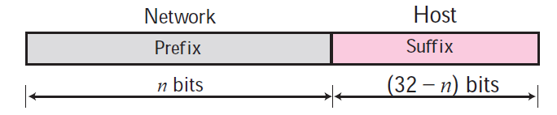
Prefix and suffix

Slide 144
Slash notation
The netid length in classful addressing or the prefix length in classless addressing play a very important role when we need to extract the information about the block from a given address in the block.
However, there is a difference here in classful and classless addressing.
In classful addressing, the netid length is inherent in the address.
Given an address, we know the class of the address that allows us to find the netid length (8, 16, or 24).
In classless addressing, the prefix length cannot be found if we are given only an address in the block.
The given address can belong to a block with any prefix length.
In classless addressing, we need to include the prefix length to each address if we need to find the block of the address.
In this case, the prefix length, n, is added to the address separated by a slash. The notation is informally referred to as slash notation. An address in classless addressing can then be represented as shown next.

Slide 145
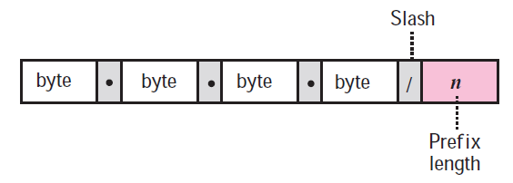
Slash notation
The slash notation is formally referred to as classless interdomain routing or CIDR (pronounced cider) notation.

Slide 146
Network mask
The idea of network mask in classless addressing is the same as the one in classful addressing.
A network mask is a 32-bit number with the n leftmost bits all set to 0s and the rest of the bits all set to 1s.
Example
In the address 12.23.24.78/8, the network mask is 255.0.0.0. The mask has eight 1s and twenty-four 0s. The prefix length is 8; the suffix length is 24.
In the address 130.11.232.156/16, the network mask is 255.255.0.0. The mask has sixteen 1s and sixteen 0s. The prefix length is 16; the suffix length is 16.
In the address 167.199.170.82/27, the network mask is 255.255.255.224. The mask has twenty-seven 1s and five 0s. The prefix length is 27; the suffix length is 5.

Slide 147
Exercise
You have the following address: 192.16.5.133/29
How many total bits are being used to identify the network, and how many total bits identify the host?
Answer: 29 bits identify the network, 3 bits identify the host.

Slide 148
Exercise
What is the full subnet mask for address 172.16.5.10/28?
Answer: 255.255.255.240
Why?
We want 28 1s in the IP address for the net id part, i.e. 11111111 11111111 11111111 11110000
This in decimal is
255.255.255.240

Slide 149
Exercise
You currently use the default mask for your IP network 192.168.1.0. You need to subnet your network so that you have 30 additional networks, and 4 hosts per network. Is this possible, and what subnet mask should you use?
Answer: It is a class C address. So, the last octet (host id) needs to be used to create 30 subnets.
192 | 168 | 1 | 0 | Decimal
11111111 | 11111111 | 11111111 | 00000000 | Binary
11111111 | 11111111 | 11111111 | 11111000 | To create 30 subnets

Slide 150
Exercise
So, our subnet mask will be:
11111111 11111111 11111111 11111000
That is
255.255.255.248
Each subnet can have up to 8 hosts (since 3 bits are left for the host id), including router address and broadcast address

Slide 151
Exercise
You still are using the default mask for your IP network 192.168.1.0. You need to subnet your network so that you have 5 additional networks, and 60 hosts per network. Is this possible, and what subnet mask should you use?
Answer: It is a class C address. So, the last octet (host id) needs to be used to create 5 subnets.
192 | 168 | 1 | 0 | Decimal
11111111 | 11111111 | 11111111 | 00000000 | Binary
11111111 | 11111111 | 11111111 | 11100000 | To create 5 subnets

Slide 152
Exercise
So, our subnet mask will be:
11111111 11111111 11111111 11100000
Now, 5 bits are left for the host id, including router address and broadcast address
Since 2⁵ = 32, each subnet can have at the most 32 hosts
So, 60 hosts per subnet are not possible

Slide 153
Exercise
Consider an IP address 10.128.240.50/30. Find the network, broadcast, and host addresses.
/30 means that the subnet mask has 30 bits 1s and 2 bits 0s. Remember the total Subnet Mask is 32 bits. So in binary mode our Subnet Mask is:
11111111.11111111.11111111.11111100 (First 30 bits are 1s and 2 bits are 0s)
And the decimal equal of this Subnet Mask is : 255.255.255.252

Slide 154
Exercise
Now, let’s determine the network, broadcast and host addresses of this prefix. An IP address with Subnet Mask is called Prefix. So, we will write the binary equals of IP address and Subnet and use AND again.
IP Add : 00001010.10000000.11110000.00110010
SubM : 11111111.11111111.11111111.11111100
AND : 00001010.10000000.11110000.00110000
The result of AND operation is the Network Address. This is 00001010.10000000.11110000.00110000 in binary. The decimal value of this is 10.128.240.48.
Here, the last two bits are host bits and the other bits are network bits. When we set all the host bits with 1s, we will find the Broadcast Address. This is 00001010.10000000.11110000.00110011 in binary. The decimal value is 10.128.240.51.

Slide 155
Exercise
The middle addresses can be used for hosts. These addresses are 10.128.240.49 and 10.128.240.50.
Network Address : 10.128.240.48
Host Addresses : 10.128.240.49 and 10.128.240.50
Broadcast Address : 10.128.240.51

Slide 156
Exercise
What will be the first valid host on the network 172.28.0.0/16?
Answer: 172.28.0.1

Slide 157
Exercise
What will be the maximum number of valid subnets and usable hosts per subnet that you can get from the network 172.17.0.0/22?
Answer:
64 and 1022

Slide 158
Exercise
Consider an IP address 173.72.248.176/25.
Answer (25 1s and 7 0s):
Network address: 173.72.248.128
First host: 173.72.248.129
Last host: 173.72.248.254
Broadcast: 173.72.248.255
Next subnet: 173.72.249.0

Slide 159
Variable Length Subnet Mask (VLSM)
In Variable Length Subnet Mask (VLSM), the subnet design uses more than one mask in the same network
Here, more than one mask is used for different subnets of a single network.
It is used to increase the usability of subnets as they can be of variable size.
It is also defined as the process of subnetting of a subnet.

Slide 160
VLSM Example
Suppose we have an ISP that is just starting up. It's not a “major” ISP, but a moderate-sized one with only a few customers, so it needs only a relatively small allocation. It begins with the block 71.94.0.0/15. The “/15” on the end of the block address tells us that this is a block of addresses where the first 15 bits are the network ID and the last 17 the host ID. Of course, this block was obtained from a larger ISP.

Slide 161
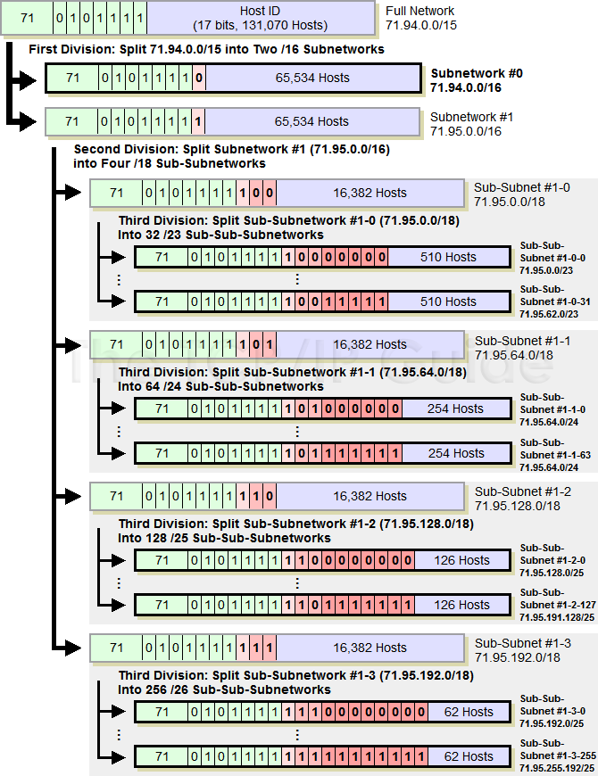

Slide 162
Variable Length Subnet Mask (VLSM)
In VLSM, subnets use block size based on requirement; so subnetting is required multiple times.
Suppose there is an administrator that has four departments to manage.
These are sales and purchase department with 120 computers, development department with 50 computers, accounts department with 26 computers and management department with 5 computers.
If the administrator has IP 192.168.1.0/24, how can department wise IPs can be allocated?

Slide 163
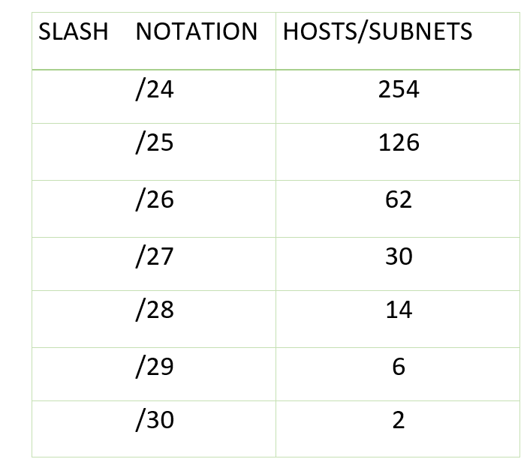
Variable Length Subnet Mask (VLSM)
Step 1: For each segment select the block size that is >= the actual requirement. Make a list of subnets possible:

Slide 164
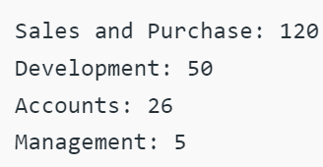
Variable Length Subnet Mask (VLSM)
Step 2: Arrange all the segments in descending order based on the block size that is from highest to lowest requirement:

Slide 165
Variable Length Subnet Mask (VLSM)
Step 3: The highest IP available has to be allocated to highest requirement, so the sales and purchase department gets 192.168.1.0/25, which has 126 valid addresses that can easily be available for 120 hosts. The subnet mask used is 255.255.255.128.
Step 4: The next segment requires an IP to handle 50 hosts. The IP subnet with network number 192.168.1.128/26 is the next highest which can be assigned to 62 hosts thus fulfilling the requirement of development department. The subnet mask used is 255.255.255.192.
Step 5: Similarly the next IP subnet 192.168.1.192/27 can fulfill the requirements of the accounts department, as it has 30 valid hosts IP which can be assigned to 26 computers. The mask used is 255.255.255.224.
Step 6: The last segment requires 5 valid hosts IP which can be fulfilled by the subnet 192.168.1.224/29 which has the mask as 255.255.255.248 is chosen as per the requirement. The IP with the mask 255.255.255.240, could be chosen but it has 14 valid host IPs and the requirement is less in comparison so the one that is comparable with the requirement is chosen. Thus there is less IP wastage in VLSM as compared to FLSM.

Slide 166
VLSM advantages
In Fixed length subnet mask subnetting (FLSM), all subnets are of equal size and have equal number of hosts but in VLSM the size is variable and it can have variable number of hosts thus making the IP addressing more efficient by allowing a routed system of different mask length to suit requirements.
In FLSM there is a wastage of IP addresses but in VLSM there is a minimum wastage of IP addresses.
FLSM is preferred for private IP addresses while for public IP addresses VLSM is the best option.

Slide 167
Network Address Translation (NAT)
ISP: Need to dynamically assign IP addresses to dial-up customers to conserve address space
Not possible in the case of “always on” connections (businesses, broadband)
Assign every company a single IP address for Internet traffic; within the company, every computer gets a unique IP address
Concept of “private addresses” – Internally can be used in any manner, not allowed on the Internet
10.0.0.0 to 10.255.255.255
172.16.0.0 to 172.31.255.255
192.168.0.0 to 192.168.255.255
An introduction to the Internet | Atul Kahate
167
Notes:
167

Slide 168
NAT Depicted
Internal network with internal IP addresses
192.168.10.1
192.168.10.2
192.168.10.3
••••
NAT router
Internet
192.168.10.10
201.26.7.9
Router’s internal IP address
Router’s external IP address
An introduction to the Internet | Atul Kahate
168
Notes:
168

Slide 169
Understanding NAT – 1
For all incoming packets, regardless of which is actually the final destination in the internal network, the destination address field would always contain the NAT router’s external address when the packet enters the network.
For all outgoing packets, regardless of which is actually the original sender in the internal network, the source address field would always contain the NAT router’s external address when the packet leaves the network.
An introduction to the Internet | Atul Kahate
169
Notes:
169

Slide 170
Understanding NAT – 2
For all incoming packets, the NAT router replaces the destination address of the packet (which is set to the NAT router’s external address) with the internal address of the final receiving host.
For all outgoing packets, the NAT router replaces the source address of the packet (which is set to the internal address of the original sender host) with the external address of the NAT router.
An introduction to the Internet | Atul Kahate
170
Notes:
170

Slide 171
NAT Depicted – 2
Internal network with internal IP addresses
192.168.10.1
Source: 192.168.10.1
Source: 201.26.7.9
NAT router
Internet
192.168.10.10
201.26.7.9
Destination: 192.168.10.1
Destination: 201.26.7.9
An introduction to the Internet | Atul Kahate
171
Notes:
171

Slide 172
NAT Translation Table
Suppose host 192.168.10.1 has sent a packet to an external host 210.10.20.20
NAT router adds the following entry to its translation table, which helps in processing responses received from 210.10.20.20
Translation table
Internal
External
192.168.10.1
…
…
210.10.20.20
…
…
An introduction to the Internet | Atul Kahate
172
Notes:
172

Slide 173
NAT Translation Table – Problems – 1
Suppose two internal hosts (192.168.10.1 and 192.168.10.2) want to send a packet to the same external host
NAT router would create the following two entries in the NAT routing table and replace the source address in the two packets with its own external address (201.26.7.9)
This is a problem, since on the return path, both packets would bear destination address as 201.26.7.9
How does the NAT router know where the reply packet is meant for 192.168.10.1 or 192.168.10.2?
An introduction to the Internet | Atul Kahate
173
Notes:
173

Slide 174
NAT Translation Table – Problems – 2
A single internal host cannot access two different applications on the same single external host (e.g. HTTP and FTP) at the same time
This happens because the NAT translation table does not maintain port numbers, but it has only IP addresses
There is no way to distinguish between one application and another
For a single internal-external host combination, our translation table has a single entry
An introduction to the Internet | Atul Kahate
174

Slide 175
Solution
Within a company, every host has a unique 10.x.y.z address
Whenever any packet leaves the company network, it is passed through a NAT box
The NAT box converts the internal address to the external address
Fine for outgoing packets, what about incoming ones?!
TCP source port is replaced by an index into the NAT box’s 65,536-entry translation table (this table contains the original IP address and original source port)
When an incoming packet is received, the TCP source port is extracted and used as an index into the translation table
When a match is found, the corresponding source port is obtained, and it replaces the one in the packet
An introduction to the Internet | Atul Kahate
175
Notes:
175

Slide 176
Modified NAT Translation Table
Internal address | Internal port | External address | External port | NAT port | Transport protocol
192.168.10.1 | 1030 | 210.10.20.20 | 80 | 14000 | TCP
192.168.10.1 | 1031 | 210.10.20.20 | 21 | 14001 | TCP
192.168.10.2 | 26601 | 210.10.20.20 | 80 | 14002 | TCP
192.168.10.3 | 1275 | 207.21.1.5 | 80 | 14003 | TCP
An introduction to the Internet | Atul Kahate
176
Notes:
176

Slide 177
Understanding Modified NAT Translation Table
The Internal port column signifies the port number used by the application program on the internal host. As per TCP/IP specifications, this port number is randomly chosen. However, this port number is important because when a response comes back from the other side corresponding to the user’s request, the user’s computer needs to know to which application program the response needs to be handed over. This is determined by this port number.
The External port column signifies the port number used by the application program on the server side. This port number is always fixed for a given application, and is known as well-known port. For example, an HTTP server always runs on port 80, an FTP server always runs on port 21, etc. This is why we see these numbers in this column.
The NAT port is a sequentially incrementing number, generated by the NAT router. This column has absolutely nothing to do with the source or destination port numbers. Instead, it is merely used like a primary key column in the translation table when a response comes back from the external host. This is explained subsequently.
The Transport protocol column is not relevant here.
An introduction to the Internet | Atul Kahate
177
Notes:
177

Slide 178
NAT Problems
Violation of the IP architectural model (one IP, one computer; here 10.20.2.2 can refer to thousands of computers across the world)
Connectionless Internet becomes connection-oriented
Protocol at layer k needs to know about protocol layer k+1 (e.g. what if new version of TCP doubles the port number bits?)
TCP source port is 16-bit, so at the most 65,536 machines can be mapped on to one IP address
An introduction to the Internet | Atul Kahate
178
Notes:
178

Slide 179
IP Communication
Notes:
179

Slide 180
IP Datagram
Version HLEN Service Type Total Length
(4 bits) (4 bits) (8 bits) (16 bits)
Identification Flags Fragmentation Offset
(16 bits) (3 bits) (13 bits)
Time to live Protocol Header Checksum
(8 bits) (8 bits) (16 bits)
Source IP address
(32 bits)
Destination IP address
(32 bits)
Data
Options
An introduction to the Internet | Atul Kahate
180
Notes:
180

Slide 181
Understanding IP Datagram – 1
Version: Currently 4, in future 6
Header Length (HLEN): Total length of the datagram in 4-byte words.
An introduction to the Internet | Atul Kahate
181
Notes:
181

Slide 182
Understanding IP Datagram – 2
Services: Contains flags such as priority, type of service needed (e.g. minimize cost), etc
Total length: This 16-bit field contains the total length (Header + Data) of the IP datagram in bytes. Maximum value 65535, of which 20-60 bytes are reserved for header.
An introduction to the Internet | Atul Kahate
182

Slide 183
Understanding IP Datagram – 3
Identification: Used in fragmentation.
Flags: Used in fragmentation.
Fragmentation offset: Used in fragmentation.
Time to live: Specifies the maximum number of hops (routers) a datagram can visit before it must be discarded. Usually has a value of twice the number of expected hops. Avoids a datagram from traveling infinitely.
Protocol: Higher protocol (TCP, UDP, ICMP, IGMP).
An introduction to the Internet | Atul Kahate
183
Notes:
183

Slide 184
Understanding IP Datagram – 4
Checksum: Used for error detection.
Source address: 32-bit source IP address.
Destination address: 32-bit destination IP address.
An introduction to the Internet | Atul Kahate
184

Slide 185
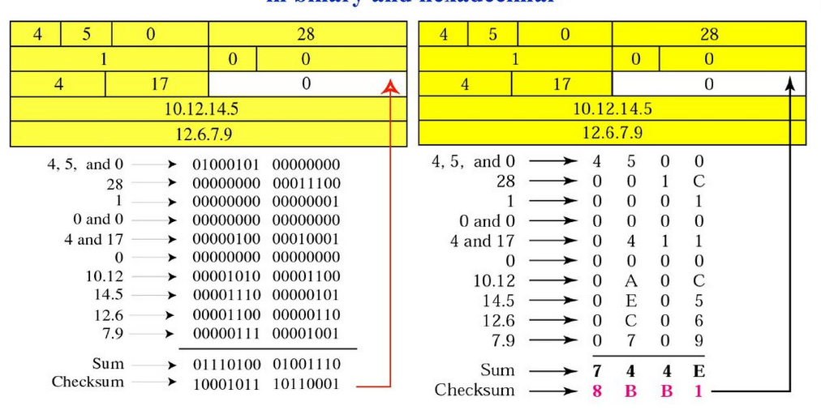
Checksum Example

Slide 186
Datagram Encapsulation
Notes:
186

Slide 187
TCP Layer Breaks Down the Original Message Into Segments
Original message
TCP Data
header
TCP Data
header
TCP Data
header
IP Header Is Added to the TCP Segments
IP header TCP header Data
An introduction to the Internet | Atul Kahate
187
Notes:
187

Slide 188
Ethernet Frame
IP header TCP header Data
Ethernet
Frame Data
header
Original IP Datagram
IP header TCP header Data
An introduction to the Internet | Atul Kahate
188
Notes:
188

Slide 189
X.25 Frame
IP header TCP header Data
X.25
Frame Data
header
Original IP Datagram
IP header TCP header Data
An introduction to the Internet | Atul Kahate
189
Notes:
189

Slide 190
Token Ring Frame
IP header TCP header Data
Token ring
Frame Data
header
Three Parts of IP Address
Class Network number Host number
An introduction to the Internet | Atul Kahate
190
Notes:
190

Slide 191
Fragmentation
Notes:
191

Slide 192
Why Fragmentation?
As a datagram travels through different physical networks, every router retrieves the IP datagram from the frame it receives, processes it, and encapsulates it inside another frame.
The format and size of the hardware frame depends on the network type.
Each data link layer protocol defines its own frame format, which specifies, among other things, what is the Maximum Transmission Unit (MTU) of the data field. The IP datagram’s data size must be less than this so that the IP datagram can fit inside the hardware frame. If not, we need fragmentation.
MTU for Ethernet is 1,500; PPP is 296; X.25 is 576.
An introduction to the Internet | Atul Kahate
192
Notes:
192

Slide 193
MTU Concept
LAN-1
MTU 3,100
LAN-2
Router
MTU 1,200
An introduction to the Internet | Atul Kahate
193

Slide 194
Fragmentation Technology
IP datagram can contain up to 65,536 bytes. This was done to make IP independent of the physical networks.
When a datagram is fragmented, each fragment has its own headers.
A fragment can get re-fragmented if it passes through a network of even lesser MTU.
Reassembly is done only at the final destination.
An introduction to the Internet | Atul Kahate
194
Notes:
194

Slide 195
Relevance to IP Datagram Format
When a datagram is fragmented, the following fields of the IP datagram are impacted:
Total length: Specifies the length of each fragment.
Identification: Identifies a datagram originating from a source to a destination. A combination of identification + source address is unique. Helps receiver in recreating the datagram from the fragments, as this value is common for all the fragments of a datagram.
Flags: Specifies whether a datagram can be fragmented, or whether there are more fragments to follow if already fragmented, etc. (See next slide)
Fragmentation offset: Shows the relative position of a fragment with respect to the whole datagram measured in 8-byte units.
An introduction to the Internet | Atul Kahate
195
Notes:
195

Slide 196

Flags Field
3-bit field
Bit 1: Reserved (Not used).
Bit 2: Do not fragment bit. If set to 1, the datagram must not be fragmented. So, drop the packet and send an ICMP error message to the sender.
Bit 3: More fragments bit. If it is set to 1, it means that the current datagram is not the last fragment. There are more fragments of the original datagram.

Slide 197
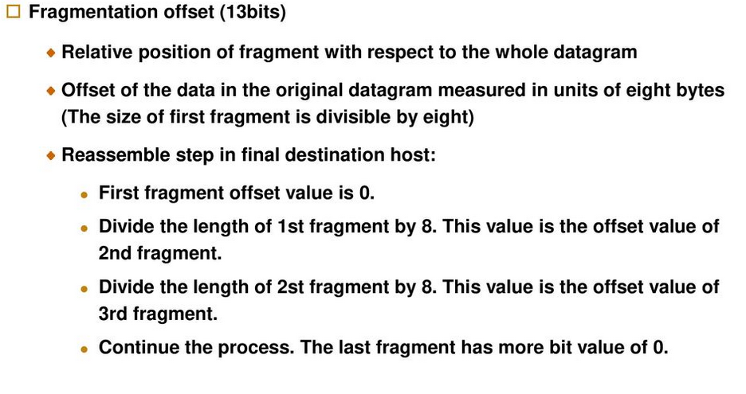
Fragmentation – More

Slide 198
Fragmentation Example
Consider an IP datagram with a data size of 4000 bytes fragmented into three fragments.
The bytes in the original datagram are numbered 0 to 3999.
The first fragment carries bytes 0 to 1399. The
offset for this datagram is 0/8 = 0.
The second fragment carries bytes 1400 to 2799; the offset value for this fragment is 1400/8 = 175.
Finally, the third fragment carries bytes 2800 to 3999. The offset value for this fragment is 2800/8 = 350.

Slide 199
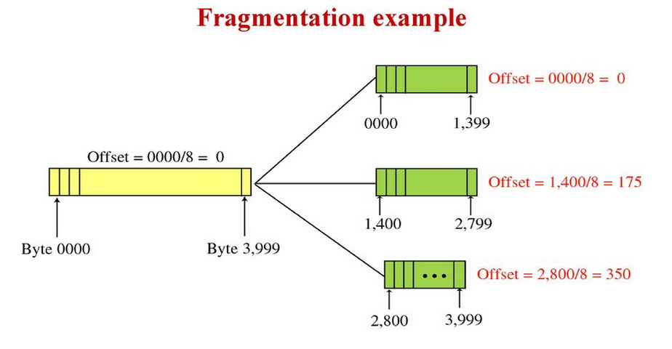
Fragmentation Example
An introduction to the Internet | Atul Kahate
199
Notes:
199

Slide 200
Fragmentation of Fragmentation
If a fragment itself is fragmented, the value of the offset field is always relative to the original datagram.
For example, in the figure, the second fragment is itself fragmented later to two fragments of 800 bytes and 600 bytes, but the offset shows the relative position of the fragments to the original data.
It is obvious that even if each fragment follows a different path and arrives out of order, the final destination host can reassemble the original datagram from the fragments received (if none of them is lost) using the following strategy:
a. The first fragment has an offset field value of zero.
b. Divide the length of the first fragment by 8. The second fragment has an offset value equal to that result.
c. Divide the total length of the first and second fragment by 8. The third fragment has an offset value equal to that result.
d. Continue the process. The last fragment has a more bit value of 0.

Slide 201
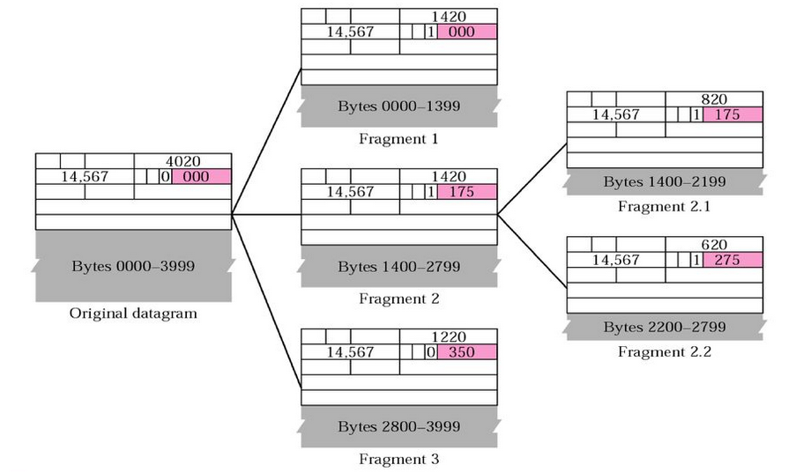
Fragmentation Example
An introduction to the Internet | Atul Kahate
201
Notes:
201

Slide 202
Delivery and Routing of IP Packets
Notes:
202

Slide 203
Connection-oriented versus Connectionless Services
Delivery of packets in network layer is done by one of these service types
Connection-oriented service (e.g. ATM)
A connection is established between the network layer protocols of the two computers and packets are sent
Guarantee of sequence
Route of packets is decided only once
Connectionless service (e.g. IP)
Every packet is independent of others
Path of different packets can be different
An introduction to the Internet | Atul Kahate
203
Notes:
203

Slide 204
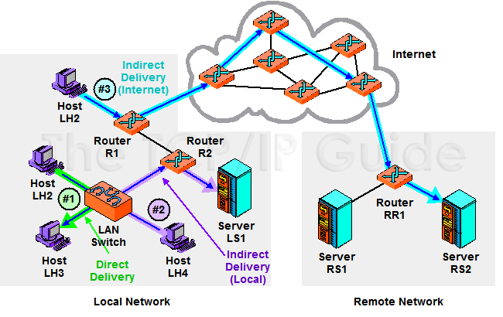
Direct and Indirect Delivery

Slide 205
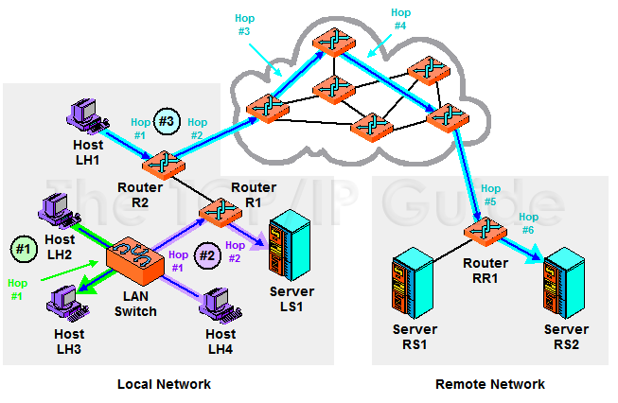
Next Hop Routing

Slide 206
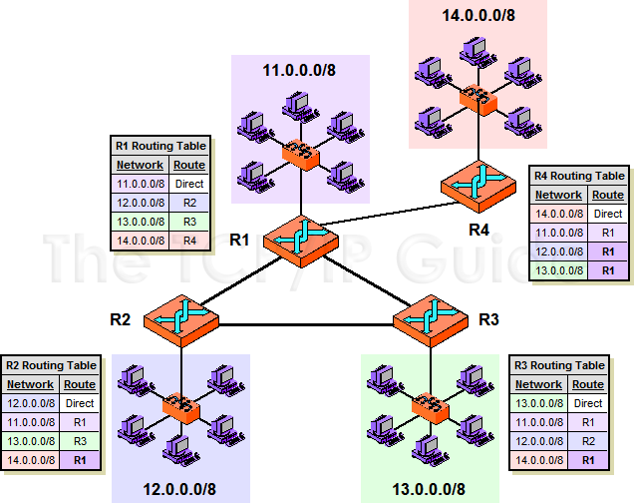
IP Routing and Routing Tables

Slide 207
Direct versus Indirect Delivery
Direct delivery: Final destination host is connected to the same physical network: Use physical address
Source
Destination
Direct delivery
….
Network
Router
To the rest of the Internet …
An introduction to the Internet | Atul Kahate
207

Slide 208
Direct versus Indirect Delivery
Indirect delivery: Final destination host is on a different physical network
Source
….
Network
Router
Network
Destination
An introduction to the Internet | Atul Kahate
208
Notes:
208

Slide 209
Routing Methods
Every host or router needs to have a routing table for sending and forwarding packets, respectively
Contains information about reaching the final destination – not practical today; so need better methods
Next-hop routing
Network-specific routing
Host-specific routing
An introduction to the Internet | Atul Kahate
209
Notes:
209

Slide 210
Next-hop Routing – 1
Routing table holds information only about the next hop; not the complete route
A
B
Network
R1
Network
R2
Network
An introduction to the Internet | Atul Kahate
210
Notes:
210

Slide 211
Next-hop Routing – 2
Routing tables: Based on route
Entry in the table of | Destination | Route
A | B | R1-R2-B
R1 | B | R2-B
R2 | B | B
An introduction to the Internet | Atul Kahate
211

Slide 212
Next-hop Routing – 3
Routing tables: Based on next hop
Entry in the table of | Destination | Next hop
A | B | R1
R1 | B | R2
R2 | B | *
An introduction to the Internet | Atul Kahate
212

Slide 213
Network-specific Routing – 1
Maintain an entry for a network, rather than for all the hosts on that network
B
C
D
S
A
E
N1
R1
N2
An introduction to the Internet | Atul Kahate
213

Slide 214
Network-specific Routing – 2
Routing table for S based on host-specific routing
Routing table for S based on network-specific routing
Destination | Next hop
A | R1
B | R1
C | R1
D | R1
Destination | Next hop
N2 | R1
An introduction to the Internet | Atul Kahate
214

Slide 215
Host-specific Routing
Opposite of network-specific routing
Used when the network administrator wants to perform certain checking or to enforce certain rules
An introduction to the Internet | Atul Kahate
215

Slide 216
Another Concept: Default Routing – 1
Use “default” routes
S
B
C
D
A
E
N1
R1
N2
R2
Remaining Internet
An introduction to the Internet | Atul Kahate
216

Slide 217
Another Concept: Default Routing – 2
Routing table for S
Destination | Next hop
N2 | R1
Default | R2
An introduction to the Internet | Atul Kahate
217

Slide 218
Static and Dynamic Routing
Static routing
Administrator manually enters and maintains routing information
Not very flexible, but simple
Dynamic routing
Routing information is obtained and maintained automatically
More efficient, but complex
An introduction to the Internet | Atul Kahate
218

Slide 219
Routing Table
Hierarchical scheme
Direct delivery entries first
Followed by Host-specific delivery entries
Followed by Network-specific entries
Followed by Default delivery entries
Fields in a routing table: Mask, Destination address, Next-hop address, Flags, Reference count, Interface
An introduction to the Internet | Atul Kahate
219

Slide 220
Routing table Example
Mask | Destination address | Next-hop address | Flags | Reference count | Use | Interface
255.0.0.0 | 124.0.0.0 | 145.6.7.23 | UG | 4 | 20 | m2
An introduction to the Internet | Atul Kahate
220

Slide 221
Routing Table Fields – 1
Mask: Mask applied to the destination IP address to find the network or subnetwork address of the destination
Host-specific routing: Mask is 255.255.255.255
Default routing: Mask is 0.0.0.0
Unsubnetted network: Mask is 255.0.0.0 (class A), 255.255.0.0 (class B) or 255.255.255.0 (class C)
An introduction to the Internet | Atul Kahate
221

Slide 222
Routing Table Fields – 2
Destination address: Host-specific or network-specific address
Next-hop address: Address of the next-hop router
Flags: Indicates whether destination is on this or another network, Destination address is network/host specific, etc
Reference count: Number of users using this route at the moment
Use: Number of packets sent via this router for this destination
Interface: Name of the interface
An introduction to the Internet | Atul Kahate
222

Slide 223
Factors in Routing Algorithms
Least cost routing
Each link is assigned a weight, and the total of all weights is computed in order to find out the “least cost”
Distributed routing
Every packet can potentially take a different route
Packet lifetime
“Time to live” concept
An introduction to the Internet | Atul Kahate
223

Slide 224
TCP/IP Protocols for Routing
Interior (Routing inside an autonomous system)
RIP
OSPF
Exterior (Routing between autonomous systems)
BGP
An introduction to the Internet | Atul Kahate
224
Notes:
224

Slide 225
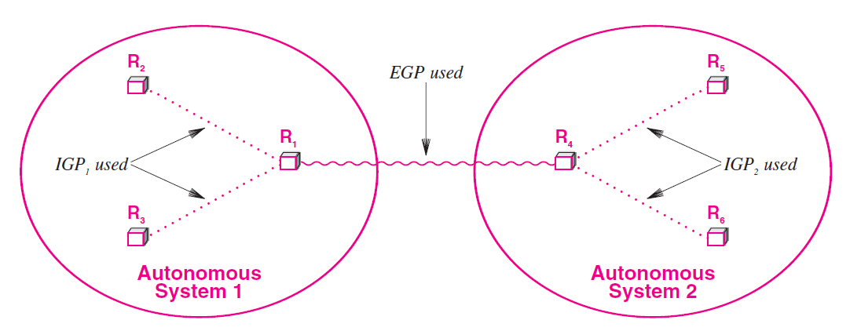
Interior and Exterior Gateway Protocols

Slide 226
RIP (Routing Information Protocol)
Interior routing protocol used inside an autonomous system
Simple, based on distance vector routing
Distance vector routing: Each router periodically shares its knowledge about the entire internet with its neighbors
An introduction to the Internet | Atul Kahate
226
Notes:
226

Slide 227
Distance vector routing
Sharing knowledge about the entire autonomous system
Sharing only with neighbors
Sharing at regular intervals
An introduction to the Internet | Atul Kahate
227
Notes:
227

Slide 228
Sample internet
B
1
2
A
6
7
C
F
5
3
E
4
D
An introduction to the Internet | Atul Kahate
228
Notes:
228

Slide 229
Distance Vector Routing
Assumption: “Cost” of every link is 1, regardless of the congestion levels or the actual cost of the links
Every router sends information to every neighbor periodically, as shown next
An introduction to the Internet | Atul Kahate
229
Notes:
229

Slide 230
Sharing information with neighbors
Sends network information periodically to A and C
Sends network information periodically to B and D
Sends network information periodically to B, F and E
B
1
2
Sends network information periodically to A
A
6
7
C
F
5
3
E
4
D
Sends network information periodically to C and E
Sends network information periodically to A and D
An introduction to the Internet | Atul Kahate
230
Notes:
230

Slide 231
Routing table
Network id | Cost | Next router
… | … | …
… | … | …
… | … | …
… | … | …
… | … | …
An introduction to the Internet | Atul Kahate
231
Notes:
231

Slide 232
Routing table creation (Next router field is empty)
Routing table
1 1 –
2 1 –
Routing table
2 1 –
3 1 –
Routing table
1 1 –
6 1 –
5 1 -
B
1
2
Routing table
6 1 –
7 1 –
A
6
7
C
F
5
3
E
4
D
Routing table
3 1 –
4 1 –
Routing table
4 1 –
5 1 –
An introduction to the Internet | Atul Kahate
232
Notes:
232

Slide 233
Router A’s update as a result of inputs from router B – Step 1
1 1 –
2 1 –
One hop
1 2 B
2 2 B
Routing table received from B
Temporary Partial table for Router A
1 1 –
6 1 –
5 1 -
1 2 B
2 2 B
1 1 –
1 2 B
2 2 B
5 1 –
6 1 -
A’s routing table
Temporary routing table
Combined table
An introduction to the Internet | Atul Kahate
233
Notes:
233
“One hop” is added because from A’s point of view, there are two steps: (1) Reach B, and (2) Reach network 1 or 2. Remember, A can reach network 1 directly. However, the current step is to purely accept what B is saying and add 1 to it, because the first hop is B, and then we have the next hop.

Slide 234
Router A’s update as a result of inputs from router B – Step 2
Remove duplicates now
1 1 –
1 2 B
2 2 B
5 1 -
6 1 –
1 1 –
2 2 B
5 1 –
6 1 -
Remove duplicates
Combined table
A’s new table
An introduction to the Internet | Atul Kahate
234
Notes:
234

Slide 235
Updated Routing Tables
Routing table
1 1 -
2 1 -
3 2 C
4 3 A
5 2 A
6 2 A
7 3 A
Routing table
1 2 B
2 1 -
3 1 -
4 2 D
5 3 D
6 3 B
7 4 B
Routing table
1 1 -
2 2 B
3 3 E
4 2 E
5 1 -
6 1 -
7 2 F
1
B
2
A
6
7
C
F
5
Routing table
1 2 A
2 3 A
3 4 A
4 3 A
5 2 A
6 1 -
7 1 -
3
E
4
D
Routing table
1 3 E
2 2 C
3 1 -
4 1 -
5 2 E
6 3 E
7 4 E
Routing table
1 2 A
2 3 A
3 2 D
4 1 -
5 1 -
6 2 A
7 3 A
An introduction to the Internet | Atul Kahate
235
Notes:
235

Slide 236
What is RIP then?
RIP provides RIP request and RIP response packet formats for sharing information across routers
RIP request: New router asks for information
RIP response: Information about routes (Can be solicited or unsolicited)
RIP messages are encapsulated inside UDP packets
An introduction to the Internet | Atul Kahate
236
Notes:
236

Slide 237
IGRP and EIGRP
The Interior Gateway Routing Protocol (IGRP) is a distance-vector routing protocol.
IGRP has been superseded by Enhanced IGRP (EIGRP), which has many new features.
IGRP and EIGRP have a compound metric that takes into account several factors, such as link bandwidth and latency.
As such, IGRP is superior to RIP, which takes into account only the hop count, and RIPv2, which uses both hop count and bandwidth.
In addition to the compound metric, which allows better route selection, IGRP tends to have better convergence times, meaning that routing stabilizes more quickly after a network disruption.
An introduction to the Internet | Atul Kahate
237
Notes:
237

Slide 238
Drawbacks
The biggest drawback of IGRP (and EIGRP) is that it’s a proprietary protocol, which means it is implemented only by Cisco routers.
If all you have on your network are Cisco devices, using IGRP is not a problem.
However, if you have a multivendor environment, you’ll be forced to use multiple routing protocols or to agree on a protocol (such as RIP or OSPF) that is supported by all your vendors.
Another disadvantage is that IGRP (like RIP) broadcasts the entire routing table, which can consume a lot of network bandwidth.
An introduction to the Internet | Atul Kahate
238
Notes:
238

Slide 239
IGRP versus EIGRP
The main reason behind the advent of EIGRP is to move away from classful routing protocols like IGRP because of the rapidly depleting IPv4 addresses. IGRP simply assumes that all elements in a given class belong to the same subnet. EIGRP utilizes variable length subnet masks (VLSM) to make more efficient use of the short supply of IPv4 addresses, prior to the advent of IPv6.
Along with the shift from classful routing protocols were a few improvements to the algorithm used to discover the best way to get around the network was introduced with EIGRP. It now uses Diffusing Update Algorithm or better known as DUAL to calculate paths while ensuring that no loops exist in the system since those are detrimental to the performance of the network.
EIGRP routers periodically broadcast a ‘hello’ packet to all systems to inform other routers that they are present and working well in the network. Updates on the other hand, are no longer broadcast to the entire network; they are bounded only to routers that need the information. Updates are also no longer periodic and only when changes in the metric are observed would the corresponding updates be sent out to other routers. The partial updates cause a reduction in network traffic compared to the full updates that are utilized by IGRP.
An introduction to the Internet | Atul Kahate
239
Notes:
239

Slide 240
OSPF (Open Shortest Path First)
Interior routing protocol
Uses Link state routing
Link state routing: Process by which a router shares its information about its neighbors
An introduction to the Internet | Atul Kahate
240
Notes:
240

Slide 241
Link State Routing
In link state routing, if each node in the domain has the entire topology of the domain
The list of nodes and links
How they are connected including the type
Cost (metric) and
The condition of the links (up or down)
An introduction to the Internet | Atul Kahate
241
Notes:
241

Slide 242
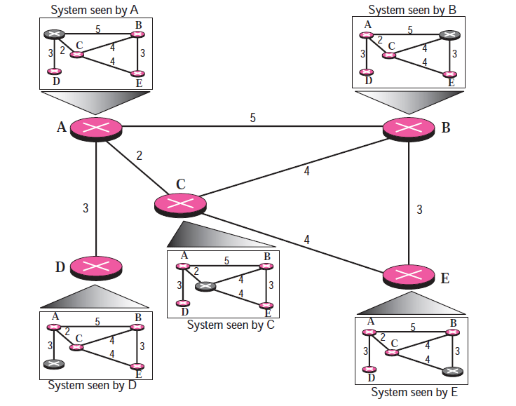
Link State Routing Concept

Slide 243
Link State Knowledge
How can a common topology be dynamic and stored in each node?
No node can know the topology at the beginning or after a change somewhere in the network.
Link state routing is based on the assumption that, although the global knowledge about the topology is not clear, each node has partial knowledge: it knows the state (type, condition, and cost) of its links.
In other words, the whole topology can be compiled from the partial knowledge of each node.

Slide 244
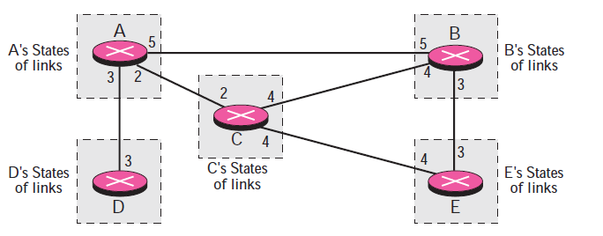
Link State Knowledge

Slide 245
Interpretation
Node A knows that it is connected to node B with metric 5, to node C with metric 2, and to node D with metric 3.
Node C knows that it is connected to node A with metric 2, to node B with metric 4, and to node E with metric 4.
Node D knows that it is connected only to node A with metric 3. And so on.
Although there is an overlap in the knowledge, the overlap guarantees the creation of a common topology: a picture of the whole domain for each node.

Slide 246
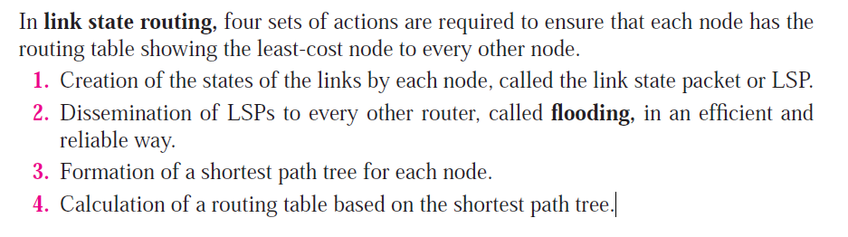
Building Routing Tables

Slide 247
Link State Packet (LSP)
A link state packet (LSP) contains the node identity, the list of links, a sequence number, and age.
The first two, node identity and the list of links, are needed to make the topology.
The third, sequence number, facilitates flooding and distinguishes new LSPs from old ones.
The fourth, age, prevents old LSPs from remaining in the domain for a long time.

Slide 248
Link State Packet (LSP)
LSPs are generated on two occasions:
1. When there is a change in the topology of the domain. Triggering of LSP dissemination is the main way of quickly informing any node in the domain to update its topology.
2. On a periodic basis. The period in this case is much longer compared to distance vector routing. As a matter of fact, there is no actual need for this type of LSP dissemination.
It is done to ensure that old information is removed from the domain.
The timer set for periodic dissemination is normally in the range of 60 minutes or 2 hours based on the implementation.
A longer period ensures that flooding does not create too much traffic on the network.

Slide 249
BGP (Border Gateway Protocol)
Inter-autonomous routing protocol
Based on path vector routing
Why not “distance vector routing” or “link state routing”?
Smallest hop count may not be the right decider every time (e.g. security)
Flooding will not work across systems, and the link state database would become huge
An introduction to the Internet | Atul Kahate
249
Notes:
249

Slide 250
Path Vector Routing Table
Network | Next router | Path
N01 | R01 | AS14, AS23, AS67
N02 | R05 | AS22, AS67, AS05, AS89
N03 | R06 | AS67, AS89, AS09, AS34
N04 | R12 | AS62, AS02, AS09
An introduction to the Internet | Atul Kahate
250
Notes:
250

Slide 251
Path Vector Routing Working
Autonomous boundary routers advertise the reachability of the networks in their autonomous systems to neighboring boundary routers
This neighbor updates its own table and forwards it to the next boundary router
An introduction to the Internet | Atul Kahate
251
Notes:
251

Slide 252
Internet Control Message Protocol (ICMP)
Notes:
252

Slide 253
Need for ICMP
IP is
Connectionless
Unreliable
Unacknowledged
Datagrams are sent over the Internet with no prior connection, no assurance of delivery, and no acknowledgement if they reach the destination successfully
What happens if a router must discard a datagram because it cannot find a router to the final destination, or because the time-to-live field has a zero value?
What happens if the final destination host must discard all fragments of a datagram because it has not received all fragments within a predetermined time limit?
Etc …
An introduction to the Internet | Atul Kahate
253
Notes:
253

Slide 254
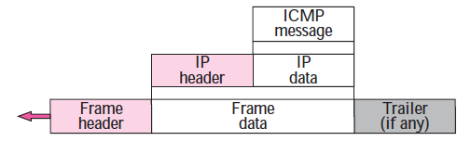
ICMP Encapsulation
Although ICMP is a network layer protocol, its messages are first encapsulated inside IP datagrams and then in the data link layer frame
An introduction to the Internet | Atul Kahate
254
Notes:
254

Slide 255
ICMP Message Types
Error-reporting messages
Report problems that a router or a host (destination) may encounter when it processes an IP packet
Query messages
Occur in pairs, help a host or a network manager get specific information from a router or another host.
For example, nodes can discover their neighbors.
Also, hosts can discover and learn about routers on their network and routers can help a node redirect its messages.

Slide 256
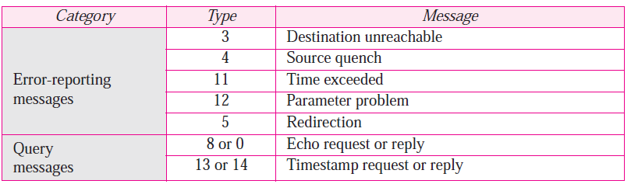
ICMP Messages
An introduction to the Internet | Atul Kahate
256
Notes:
256

Slide 257
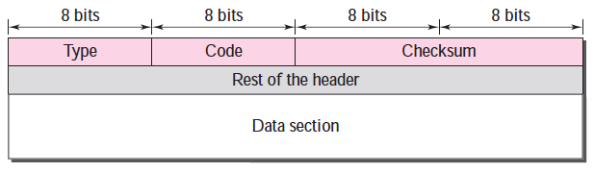
ICMP Message Format
Has a 8-byte header and variable-size data section
General format of the header is different for each message type, the first 4 bytes are common to all
Defines the type of the message
Specifies the reason for the specific message type
Carries information for finding the original packet that had error

Slide 258
ICMP: Error-reporting messages
Notes:
258

Slide 259
Error Reporting
ICMP only reports errors; does not attempt to correct them
Error messages are always sent to the original source (because the only information available in IP datagrams is about the source and the destination addresses)
An introduction to the Internet | Atul Kahate
259
Notes:
259

Slide 260
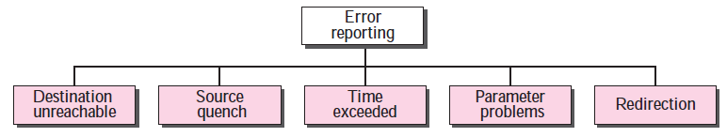
Error-reporting Messages
Type = 3
Type = 4
Type = 11
Type = 12
Type = 5

Slide 261
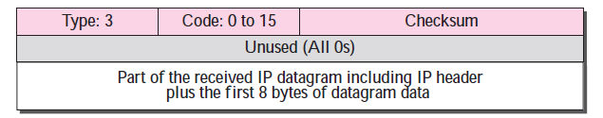
1. Destination Unreachable
When a router cannot route an IP datagram, it sends this message
An introduction to the Internet | Atul Kahate
261
Notes:
261

Slide 262
1. Destination Unreachable – Sample ‘Code’ field Values
Code 0: Network is unreachable
Code 1: Host is unreachable
Code 2: Protocol is unreachable (e.g. TCP is not running on the destination)
Code 3: Port is not reachable
Code 4: Fragmentation is needed, but “Do not fragment” field is set
Code 6: Destination network is unknown
Code 7: Destination host does not exist
An introduction to the Internet | Atul Kahate
262
Notes:
262

Slide 263
2. Source Quench
IP lacks “flow control”
Sending host does not know if there is intermediate congestion, or whether it is sending datagrams faster than what the routers can consume
Buffer/queue may get an overflow
When a router/host discards a datagram due to congestion, it generates this message
Source comes to know about this
Source would ideally slow down its transmission
An introduction to the Internet | Atul Kahate
263
Notes:
263

Slide 264
3. Time Exceeded
Caused when “Time to live” (TTL) count in the IP datagram becomes 0 (Code 0)
Can also happen if all the fragments of a fragmented packet do not arrive at the destination in time (Code 1)
When the first fragment is received, the destination sets a timer
If the other fragments do not arrive before the timer expires, this message is generated
An introduction to the Internet | Atul Kahate
264
Notes:
264

Slide 265
4. Parameter Problem
Something is wrong in the header
Required part of an option is missing
An introduction to the Internet | Atul Kahate
265
Notes:
265

Slide 266
5. Redirection
Routing tables in routers are updated dynamically, but the ones in hosts are static
This is efficient, but can cause problems of not reflecting the changes in routing tables of routers into those of hosts
Hosts may send datagrams via old path; A router would correct this and inform the source so that it can update its routing table (See figure)
Datagram is not discarded, unlike other error-reporting messages
An introduction to the Internet | Atul Kahate
266
Notes:
266

Slide 267
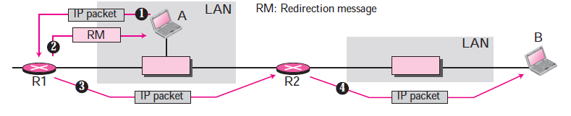
Redirection

Slide 268
ICMP: Query messages
Notes:
268

Slide 269
1. Echo Request and Reply
Used to check whether IP communication is possible between a source and a destination
Used to identify network problems (by testing the reachability)
“ping” command
An introduction to the Internet | Atul Kahate
269
Notes:
269

Slide 270
2. Timestamp Request and Response
Used to determine the round-trip time needed for an IP datagram to travel from a source to a destination
Can also be used for synchronizing clocks between two machines
An introduction to the Internet | Atul Kahate
270
Notes:
270

Slide 271
Transport Layer
Notes:
271

Slide 272
Transport Layer Protocols on the Internet
Transport Layer Protocols
Transmission Control Protocol (TCP)
User Datagram Protocol (UDP)
An introduction to the Internet | Atul Kahate
272
Notes:
272

Slide 273
Levels at Which TCP/UDP and IP Reside
Application A
Application C
…
Application B
Application D
…
Host X
Host Y
Internet
IP communication
TCP/UDP communication
An introduction to the Internet | Atul Kahate
273
Notes:
273

Slide 274
Transport layer’s View of the Internet Communication System
Computer A Computer B
The underlying communication system as viewed by TCP/UDP
Application
TCP/UDP
IP
Data Link
Application
TCP/UDP
IP
Data Link
Router
IP
Data Link
Network A
Network B
An introduction to the Internet | Atul Kahate
274
Notes:
274

Slide 275
TCP/UDP Acts As a Multiplexer-Demultiplexer
Application programs at the sender’s end
Application programs at the destination’s end
TCP/UDP (Multiplexer)
TCP/UDP (Demultiplexer)
IP
IP
Physical Network
Physical Network
An introduction to the Internet | Atul Kahate
275
Notes:
275

Slide 276
Use of Port Numbers
Application A
Application C
Application B
Application D
Port 80
Port 13
…
Destination IP address = 192.20.10.10
Port number = 80
…
…
Destination IP address = 192.20.10.10
Port number = 80
…
Host X
Host Y
IP address 192.20.10.10
An introduction to the Internet | Atul Kahate
276
Notes:
276

Slide 277
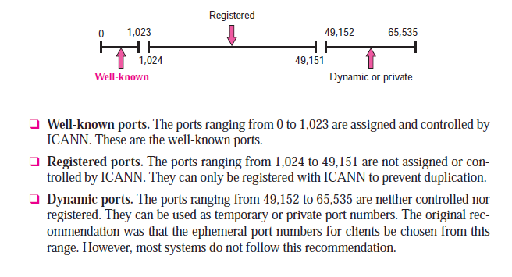
Port Number Ranges

Slide 278
Source and Destination Port Numbers
…
Source Port Number = 1050
Destination Port Number = 80
…
Client
Server
…
Source Port Number = 80
Destination Port Number = 1050
…
An introduction to the Internet | Atul Kahate
278
Notes:
278

Slide 279
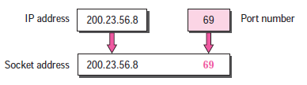
Socket Address

Slide 280
User Datagram Protocol (UDP)
Notes:
280

Slide 281
UDP Basics
Use of port numbers
No flow control
No acknowledgements
Primitive error control
Drop packets in error
Connectionless, unreliable
Does not add anything to the IP model, except the change from host-to-host to process-to-process communication
An introduction to the Internet | Atul Kahate
281
Notes:
281

Slide 282
Port numbers
Number between 0 and 65,535
Ephemeral port number
Client port number: chosen randomly
Well-known port number
Server port number: Pre-defined (0 to 1023)
An introduction to the Internet | Atul Kahate
282
Notes:
282

Slide 283
UDP Datagram Format
8-byte header divided into four fields
2 bytes
2 bytes
2 bytes
2 bytes
Source Port Number
Destination Port Number
Total Packet Length
Checksum
Data
An introduction to the Internet | Atul Kahate
283
Notes:
283

Slide 284
Length field
2-byte (16-bit) number, hence can define 0 to 65,535
An introduction to the Internet | Atul Kahate
284
Notes:
284

Slide 285
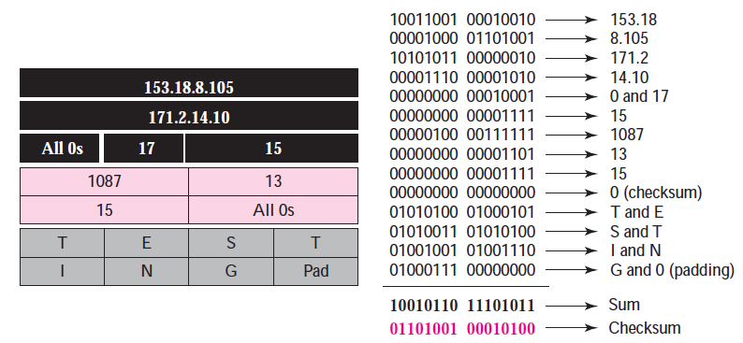
Checksum Example
An introduction to the Internet | Atul Kahate
285
Notes:
285

Slide 286
UDP Operation
Connectionless service
Each UDP datagram is independent
No connection establishment
No numbering of datagrams
No chopping of user data into smaller datagrams: User data must be small enough to fit inside a UDP datagram
Flow and error control
No flow control
Error control: Checksum
Packets can be lost or duplicated
An introduction to the Internet | Atul Kahate
286
Notes:
286

Slide 287
What UDP Does
Higher-layer Data Transfer: An application sends a message to UDP software.
UDP Message Encapsulation: The higher-layer message is encapsulated into the Data field of a UDP message. The UDP headers are filled (e.g. source and destination ports, and optionally checksum).
Transfer message to IP: The UDP datagram is passed to IP for transmission.
An introduction to the Internet | Atul Kahate
287
Notes:
287

Slide 288
Transmission Control Protocol (TCP)
Notes:
288

Slide 289
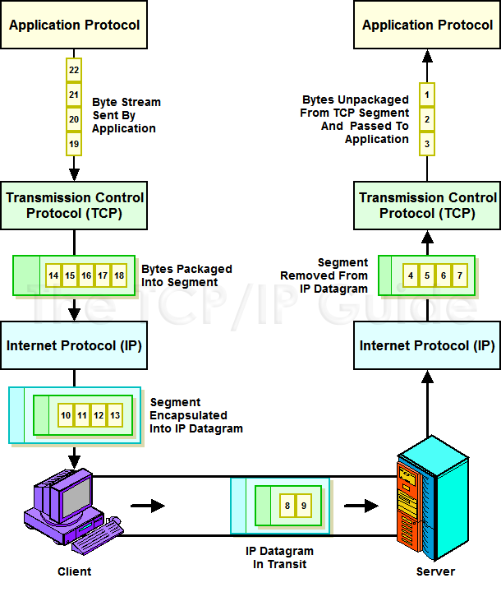
An introduction to the Internet | Atul Kahate
289

Slide 290
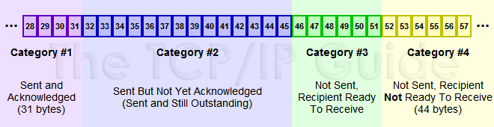
Conceptual Categories of TCP Transmission
An introduction to the Internet | Atul Kahate
290

Slide 291
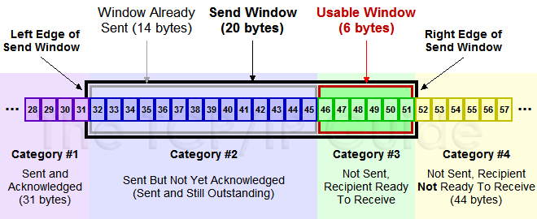
Sender’s Window Example
An introduction to the Internet | Atul Kahate
291

Slide 292
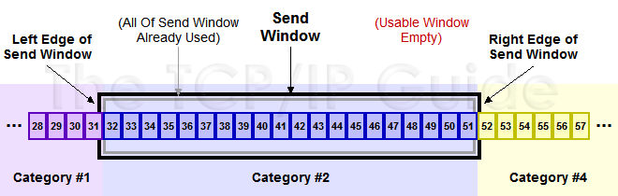
Sender’s Window After Usable Window is Used
An introduction to the Internet | Atul Kahate
292

Slide 293
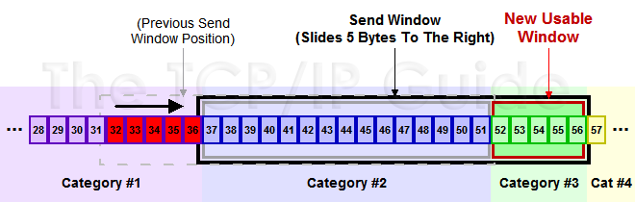
Sliding the TCP Send Window
An introduction to the Internet | Atul Kahate
293

Slide 294
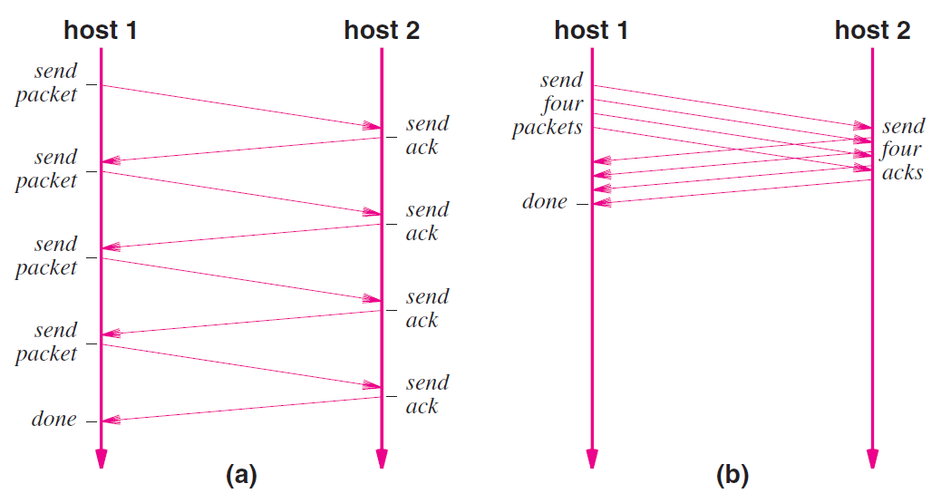
Stop-and-Go versus Sliding Window

Slide 295
TCP Segment Format
Notes:
295

Slide 296
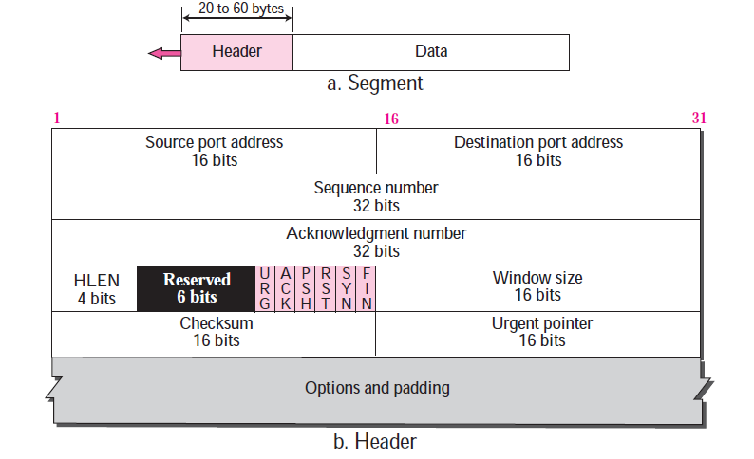
TCP Segment Format
An introduction to the Internet | Atul Kahate
296
Notes:
296

Slide 297
Understanding TCP Segments – 1
Source port address: 16-bit field, defines the port of the sending host application
Destination port address: 16-bit field, defines the port of the destination host application
Sequence number: 32-bit field defines the number assigned to the first byte of data contained in this segment. Receiver uses this for sequencing segments. (See next slide)
Acknowledgment number: 32-bit field defines the byte number that the receiver of the segment is expecting to receive from the other party. E.g. if the receiver has received byte numbered k, it defines the acknowledgment number as k + 1. (See next slide)
An introduction to the Internet | Atul Kahate
297
Notes:
297

Slide 298
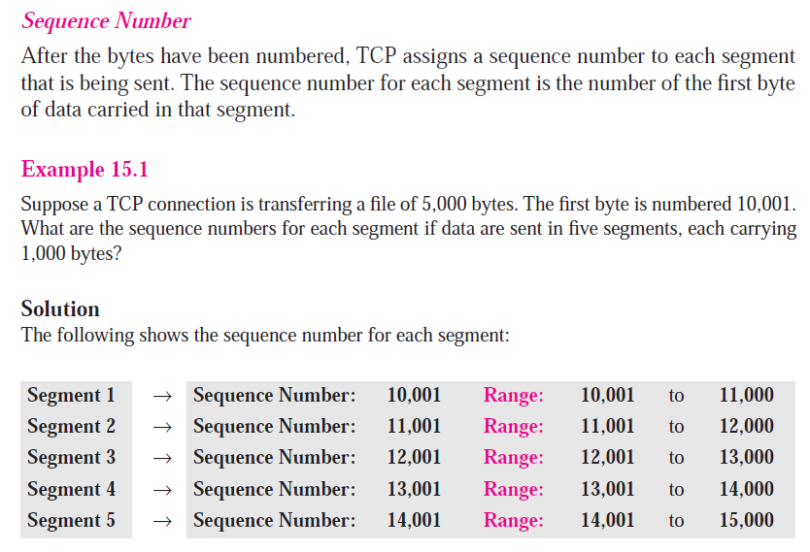
Sequence Number Example
An introduction to the Internet | Atul Kahate
298
Notes:
298

Slide 299
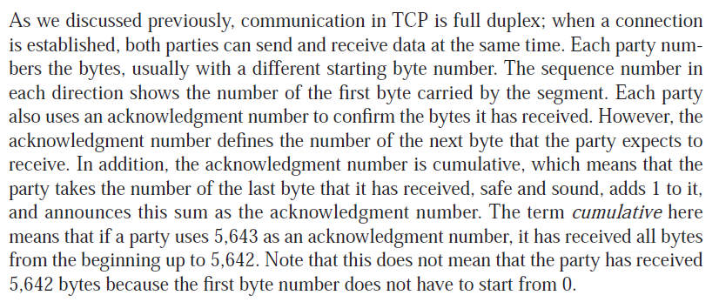
More about Acknowledgement Number
An introduction to the Internet | Atul Kahate
299
Notes:
299

Slide 300
Understanding TCP Segments – 2
Header length: Length in 4-byte words.
Reserved: Future usage.
Flag/Control: SYN, FIN, ACK, etc.
Window size: 16-bit size of the window in bytes that the other side must maintain. Called as “receiving window” that the sender must obey.
Checksum: Used for error detection.
Urgent pointer: Used if data is urgent.
Options: Not relevant.
An introduction to the Internet | Atul Kahate
300
Notes:
300

Slide 301
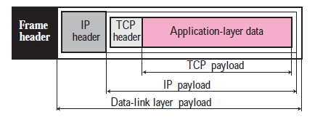
TCP Encapsulation
An introduction to the Internet | Atul Kahate
301
Notes:
301

Slide 302
TCP Connections
Notes:
302

Slide 303
Connection Establishment
TCP transmits data in full-duplex mode
When two TCPs in two machines are connected, they are able to send segments to each other simultaneously
This implies that each party must initialize communication and get approval from the other party before any data are transferred
An introduction to the Internet | Atul Kahate
303
Notes:
303

Slide 304
Three-way Handshaking
The connection establishment in TCP is called three-way handshaking
An application program, called the client, wants to make a connection with another application program, called the server, using TCP as the transport layer protocol
An introduction to the Internet | Atul Kahate
304
Notes:
304

Slide 305
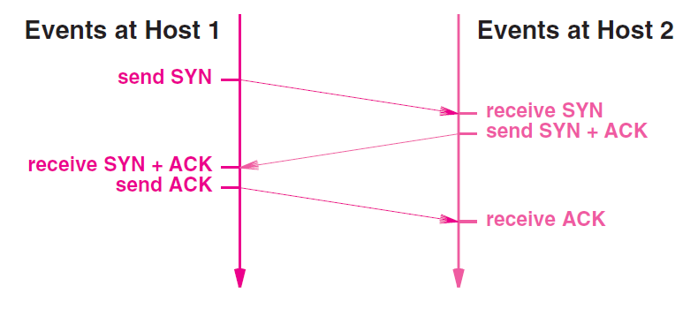
Three-way Handshaking
An introduction to the Internet | Atul Kahate
305
Notes:
305

Slide 306
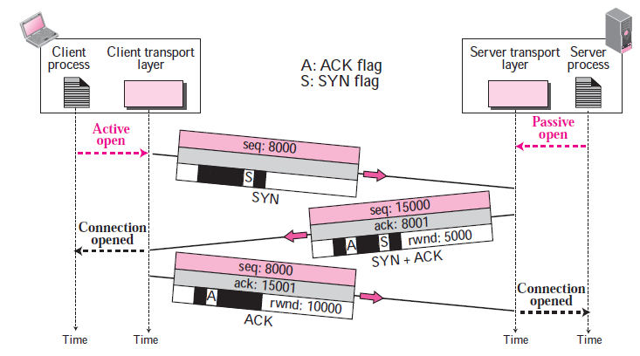
Three-way Handshake Example

Slide 307

Client sends a SYN
The client sends the first segment, a SYN segment, in which only the SYN flag is set
This segment is for synchronization of sequence numbers
The client in our example chooses a random number as the first sequence number and sends this number to the server
This sequence number is called the initial sequence number (ISN)
Note that this segment does not contain an acknowledgment number
It does not define the window size either; a window size definition makes sense only when a segment includes an acknowledgment
Note that the SYN segment is a control segment and carries no data
However, it consumes one sequence number
When the data transfer starts, the ISN is incremented by 1

Slide 308

Server sends a SYN + ACK
The server sends the second segment, a SYN + ACK segment with two flag bits set: SYN and ACK
This segment has a dual purpose
First, it is a SYN segment for communication in the other direction
The server uses this segment to initialize a sequence number for numbering the bytes sent from the server to the client
The server also acknowledges the receipt of the SYN segment from the client by setting the ACK flag and displaying the next sequence number it expects to receive from the client
Because it contains an acknowledgment, it also needs to define the receive window size, rwnd (to be used by the client), as we will see in the flow control section

Slide 309
Client sends a ACK
The client sends the third segment
This is just an ACK segment
It acknowledges the receipt of the second segment with the ACK flag and acknowledgment number field
Note that the sequence number in this segment is the same as the one in the SYN segment; the ACK segment does not consume any sequence numbers
The client must also define the server window size
Some implementations allow this third segment in the connection phase to carry the first chunk of data from the client
In this case, the third segment must have a new sequence number showing the byte number of the first byte in the data
In general, the third segment usually does not carry data and consumes no sequence numbers

Slide 310
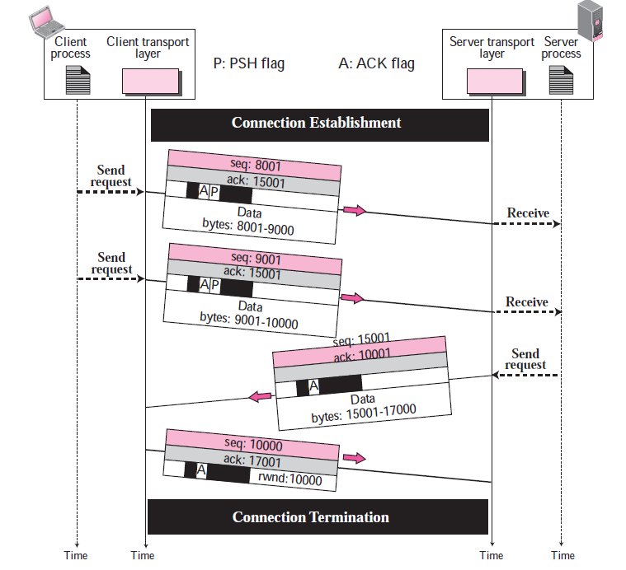
Data Transfer

Slide 311
Data Transfer
After connection is established, bidirectional data transfer can take place
The client and server can send data and acknowledgments in both directions
Data traveling in the same direction as an acknowledgment are carried on the same segment
Here, the client sends 2,000 bytes of data in two segments
The server then sends 2,000 bytes in one segment
The client sends one more segment
The first three segments carry both data and acknowledgment, but the last segment carries only an acknowledgment because there is no more data to be sent
Note the values of the sequence and acknowledgment numbers
The data segments sent by the client have the PSH (push) flag set so that the server TCP tries to deliver data to the server process as soon as they are received

Slide 312
Connection Termination
Two options
Three-way Handshaking
Four-way Handshaking with a Half-close option

Slide 313
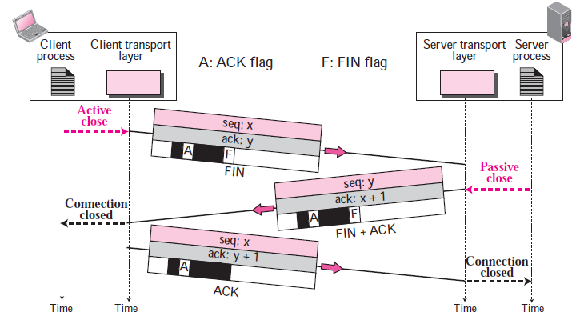
Three-way Handshaking

Slide 314

FIN from the Client
In a common situation, the client TCP, after receiving a close command from the client process, sends the first segment, a FIN segment in which the FIN flag is set
Note that a FIN segment can include the last chunk of data sent by the client or it can be just a control segment as shown in the figure
If it is only a control segment, it consumes only one sequence number

Slide 315
FIN + ACK from the Server
The server TCP, after receiving the FIN segment, informs its process of the situation and sends the second segment, a FIN+ACK segment, to confirm the receipt of the FIN segment from the client and at the same time to announce the closing of the connection in the other direction
This segment can also contain the last chunk of data from the server
If it does not carry data, it consumes only one sequence number

Slide 316
ACK from the Client
The client TCP sends the last segment, an ACK segment, to confirm the receipt of the FIN segment from the TCP server
This segment contains the acknowledgment number, which is one plus the sequence number received in the FIN segment from the server
This segment cannot carry data and consumes no sequence numbers.

Slide 317
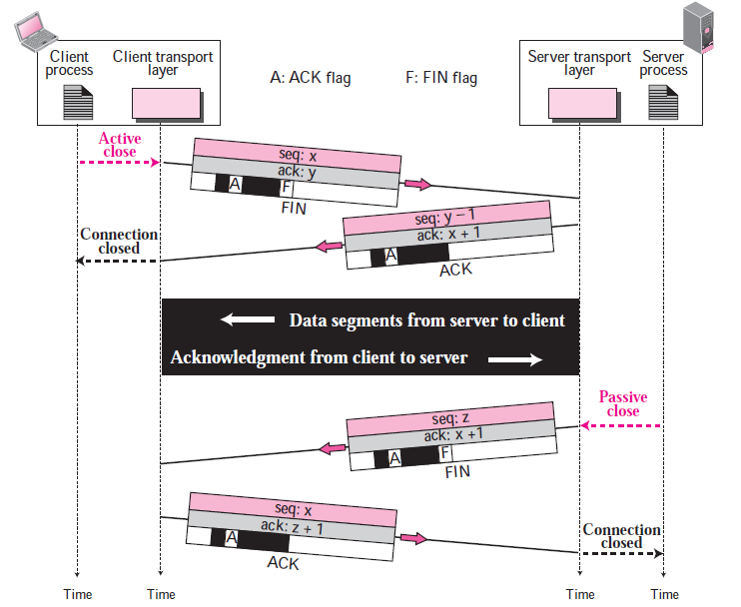
Half-Close

Slide 318
Half-Close
In TCP, one end can stop sending data while still receiving data
This is called a half close
Either the server or the client can issue a half-close request
It can occur when the server needs all the data before processing can begin
A good example is sorting
When the client sends data to the server to be sorted, the server needs to receive all the data before sorting can start
This means the client, after sending all data, can close the connection in the client-to-server direction
However, the server-to-client direction must remain open to return the sorted data
The server, after receiving the data, still needs time for sorting; its outbound direction must remain open

Slide 319
Error Control in TCP
Notes:
319

Slide 320
Four Aspects of Reliability in Transport Layer Delivery
Reliability
Error control
Loss control
Sequence control
Duplication control
An introduction to the Internet | Atul Kahate
320
Notes:
320

Slide 321
Transport Layer and Data Link Layer Error Control
Errors can be introduced here
Errors can be introduced here
Router
Router
Error control at the data link layer
Error control at the transport layer
An introduction to the Internet | Atul Kahate
321
Notes:
321

Slide 322
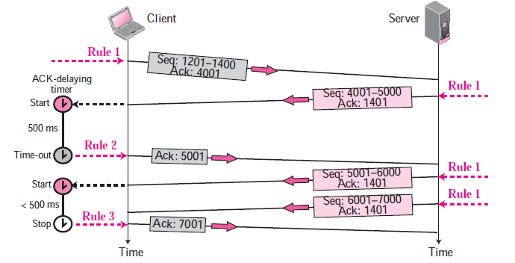
Normal Operation

Slide 323
Loss Control
Packet 3
Packet 3
Packet 2
Lost
Lost
Packet 1
Packet 1
Packet 2
A
R1
R2
B
R3
R4
Packet 3
Packet 1
An introduction to the Internet | Atul Kahate
323
Notes:
323

Slide 324
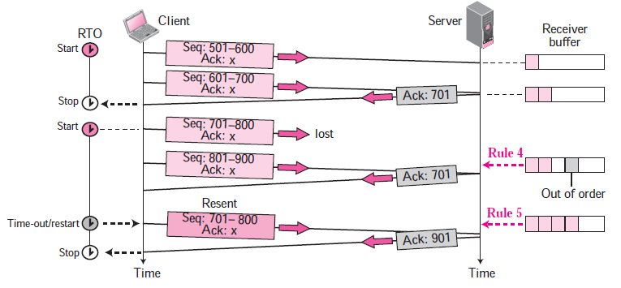
Lost Segment

Slide 325
Lost Segment
We are assuming that data transfer is unidirectional: one site is sending, the other receiving
In our scenario, the sender sends segments 1 and 2, which are acknowledged immediately by an ACK
Segment 3, however, is lost
The receiver receives segment 4, which is out of order
The receiver stores the data in the segment in its buffer but leaves a gap to indicate that there is no continuity in the data
The receiver immediately sends an acknowledgment to the sender displaying the next byte it expects
Note that the receiver stores bytes 801 to 900, but never delivers these bytes to the application until the gap is filled
The sender TCP keeps one RTO timer for the whole period of connection
When the third segment times out, the sending TCP resends segment 3, which arrives this time and is acknowledged properly

Slide 326
Sequence Control
Packet 3
Packet 2
Packet 2
Packet 3
Packet 1
Packet 1
Packet 2
A
R1
R2
B
R3
R4
Packet 3
Packet 1
An introduction to the Internet | Atul Kahate
326
Notes:
326

Slide 327
Duplication Control
Discard
Packet 3
Packet 3
Packet 3
Packet 2
Packet 2
Packet 1
Packet 3
Packet 2
Packet 1
A
R1
R2
B
R3
R4
Packet 3
Packet 1
An introduction to the Internet | Atul Kahate
327
Notes:
327

Slide 328
Flow Control in TCP
Notes:
328

Slide 329
Windows in TCP
TCP uses two windows (send window and receive window) for each direction of data transfer, which means four windows for a bidirectional communication
However, to make the discussion simple, we make an unrealistic assumption that communication is only unidirectional (say from client to server)

Slide 330
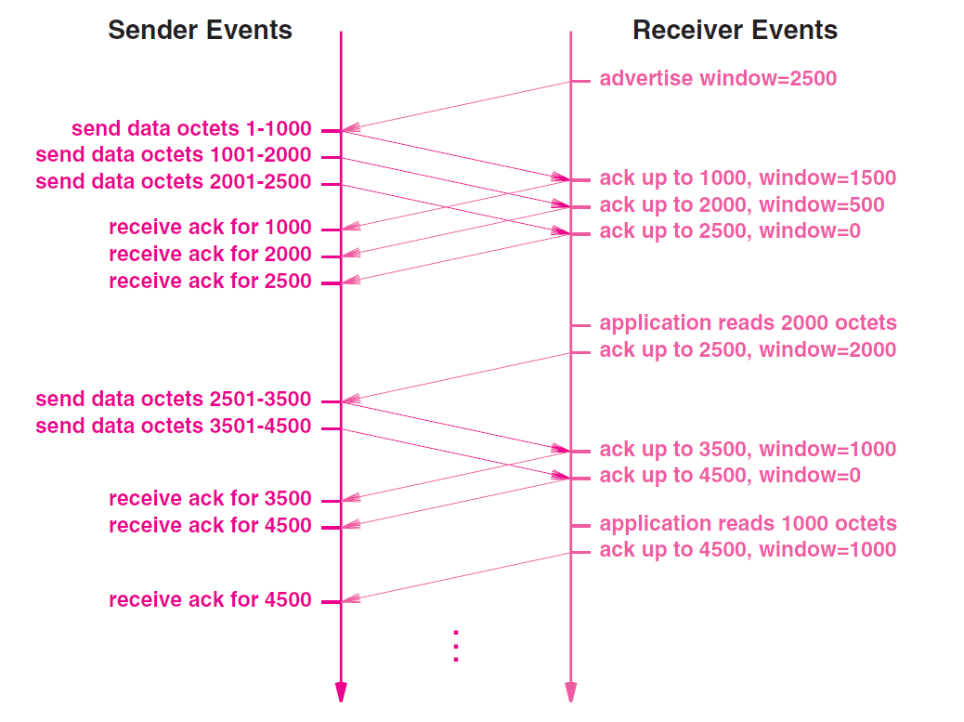
Windows in TCP

Slide 331

Explanation

Slide 332
UDP and TCP Comparison
Characteristic / Description | UDP | TCP
General Description | Simple, high-speed, low-functionality “wrapper” that interfaces applications to the network layer and does little else. | Full-featured protocol that allows applications to send data reliably without worrying about network layer issues.
Protocol Connection Setup | Connectionless; data is sent without setup. | Connection-oriented; connection must be established prior to transmission.
Data Interface To Application | Message-based; data is sent in discrete packages by the application. | Stream-based; data is sent by the application with no particular structure.
Reliability and Acknowledgments | Unreliable, best-effort delivery without acknowledgments. | Reliable delivery of messages; all data is acknowledged.
Retransmissions | Not performed. Application must detect lost data and retransmit if needed. | Delivery of all data is managed, and lost data is retransmitted automatically.
Features Provided to Manage Flow of Data | None | Flow control using sliding windows; window size adjustment heuristics; congestion avoidance algorithms.
Overhead | Very low | Low, but higher than UDP
Transmission Speed | Very high | High, but not as high as UDP
Data Quantity Suitability | Small to moderate amounts of data (up to a few hundred bytes) | Small to very large amounts of data (up to gigabytes)
Types of Applications That Use The Protocol | Applications where data delivery speed matters more than completeness, where small amounts of data are sent; or where multicast/broadcast are used. | Most protocols and applications sending data that must be received reliably, including most file and message transfer protocols.
Well-Known Applications and Protocols | Multimedia applications, DNS, BOOTP, DHCP, TFTP, SNMP, RIP, NFS (early versions) | FTP, Telnet, SMTP, DNS, HTTP, POP, NNTP, IMAP, BGP, IRC, NFS (later versions)
An introduction to the Internet | Atul Kahate
332

Slide 333
INTERNETWORKING DEVICES
An introduction to the Internet | Atul Kahate
333

Slide 334
Internetworking Devices
Connecting devices
Networking
devices
Internetworking devices
Repeaters
Bridges
Routers
Gateways
An introduction to the Internet | Atul Kahate
334
Notes:
334

Slide 335
Internetworking Devices - Details
Device | Purpose | Present in which OSI Layer
Repeaters | Electrical specifications of a signal | Physical
Bridges | Addressing protocols | Data link
Routers | Internetworking between compatible networks | Network
Gateways | Translation services between incompatible networks | All
An introduction to the Internet | Atul Kahate
335
Notes:
335

Slide 336
Repeater
Also called regenerator
Simply reproduces a signal
Takes care of attenuation problems
Not intelligent
Not same as amplifier
An introduction to the Internet | Atul Kahate
336
Notes:
336

Slide 337
Repeater Concept
A
B
Application
Presentation
Session
Transport
Network
Data Link
Physical
Application
Presentation
Session
Transport
Network
Data Link
Physical
Repeater
An introduction to the Internet | Atul Kahate
337
Notes:
337

Slide 338
Repeater Function
A
D
Repeater
01100110
01100110
B
C
An introduction to the Internet | Atul Kahate
338
Notes:
338

Slide 339
Bridge
Computer with its own processor, memory, and two NICs
Divides a network into segments
Less intelligent than a router
Prevents unnecessary traffic flow across segments
An introduction to the Internet | Atul Kahate
339
Notes:
339

Slide 340
Bridge Concept
A
Segment 1
D
Repeater
B
C
Bridge
E
H
Repeater
F
G
Segment 2
An introduction to the Internet | Atul Kahate
340
Notes:
340

Slide 341
Bridge Function
A
Segment 1
D
10100010
10100010
Repeater
B
C
Bridge
E
H
Repeater
F
G
Segment 2
An introduction to the Internet | Atul Kahate
341
Notes:
341

Slide 342
Bridge Types
Simple
Manual
Keeps information about hosts and segment numbers
Learning
Intelligent
Builds its routing table during traffic of frames
Multiport
Specialized simple/learning bridge
Connects more than two network segments
An introduction to the Internet | Atul Kahate
342
Notes:
342

Slide 343
Router
More intelligent than a repeater or a bridge
Operates at the network layer
Responsible for logical addressing and delivery of packets
An introduction to the Internet | Atul Kahate
343
Notes:
343

Slide 344
Router Concept
A
B
Application
Presentation
Session
Transport
Network
Data Link
Physical
Application
Presentation
Session
Transport
Network
Data Link
Physical
Router
An introduction to the Internet | Atul Kahate
344
Notes:
344

Slide 345
Gateway
Most powerful internetworking device
Operates at all layers
Can also do protocol conversion
An introduction to the Internet | Atul Kahate
345
Notes:
345

Slide 346
Gateway Concept
A
B
Application
Presentation
Session
Transport
Network
Data Link
Physical
Gateway
Application
Presentation
Session
Transport
Network
Data Link
Physical
An introduction to the Internet | Atul Kahate
346
Notes:
346

Slide 347
Using a Serial Line to Connect to the Internet: SLIP and PPP
Notes:
347

Slide 348
SLIP and PPP
TCP/IP’s core protocols work from layer 3 (Internet layer) upwards
Layer 2 technologies are usually LAN or WAN
But what about users who want to use the Internet from home, cyber café, etc?
Need to have a serial line protocol mechanism
SLIP and PPP
An introduction to the Internet | Atul Kahate
348
Notes:
348

Slide 349
Serial Line Internet Protocol (SLIP)
Notes:
349

Slide 350
SLIP Basics
Simple data link layer protocol to allow IP to operate over serial lines
SLIP has never been a formalized standard
Rudimentary, stop-gap protocol
Provides very basic, minimal features
Has many drawbacks
An introduction to the Internet | Atul Kahate
350
Notes:
350

Slide 351
SLIP Operation
An IP datagram is passed to SLIP
SLIP breaks it into bytes and sends those bytes one at a time to the other side
After the last byte is sent, SLIP sends a special byte value, called as SLIP END character (ASCII 192)
Optionally, the bytes in a datagram may also precede with an END character
If data contains the END character itself (i.e. ASCII 192), SLIP sends 219 220 instead of sending 192 (219 is an ESCAPE SEQUENCE)
If 219 itself needs to be sent in data, SLIP sends 219 221
An introduction to the Internet | Atul Kahate
351
Notes:
351

Slide 352
SLIP Limitations
Does not define a Maximum Transmission Unit (MTU), meaning that the Internet layer has to deal with it
No error detection or correction mechanism
Errors in individual bytes cannot be detected, only when the entire IP datagram is received by the receiver, it can validate checksum at Internet layer
No control messaging for link management
No support for compression
No addressing mechanisms
No security features
An introduction to the Internet | Atul Kahate
352
Notes:
352

Slide 353
Point-to-Point Protocol (PPP)
Notes:
353

Slide 354
PPP Basics
Vast improvement over SLIP
SLIP’s drawbacks are PPP’s advantages
Recommended protocol for IP over serial lines
An introduction to the Internet | Atul Kahate
354
Notes:
354

Slide 355
PPP Advantages
More comprehensive framing mechanism than just adding an END character at the end of a frame
CRC is added to individual frames to implement error detection and correction
Link parameter negotiation is possible, including specification of MTU
Link testing and monitoring is possible
User authentication is supported
Optionally supports compression, encryption, link sharing
An introduction to the Internet | Atul Kahate
355
Notes:
355

Slide 356
PPP Main Components
PPP Encapsulation Method
PPP defines a special frame format to encapsulate IP datagrams into data link layer frames before sending them – the frame format is based on High Level Data Link Control (HDLC) protocol, initially developed by IBM and later standardized by ISO
Link Control Protocol (LCP)
Responsible for setting up, maintaining, and terminating the link
Network Control Protocol (NCPs)
Supports many network layer protocols, e.g. for IP, it is PPP Internet Protocol Control Protocol (IPCP)
An introduction to the Internet | Atul Kahate
356
Notes:
356

Slide 357
PPP Functional Groups
LCP Support Protocols
Password Authentication Protocol (PAP) and Challenge Handshake Authentication Protocol (CHAP)
LCP Optional Feature Protocols
Compression Control Protocol (CCC), Encryption Control Protocol (ECP), etc
An introduction to the Internet | Atul Kahate
357
Notes:
357

Slide 358
PPP: General Operation
Link setup and configuration
Before the two devices can exchange information, they must make contact and set up a link between them
Devices agree on all the parameters needed for link operation
Appropriate NCP is called
Link operation
Devices use the link to send/receive datagrams by encapsulating them into PPP frames
Link termination
Either device can initiate this step to break the connection
An introduction to the Internet | Atul Kahate
358
Notes:
358

Slide 359
PPP Link Set up and Phases
LCP has to get into action for link set up
Optionally authentication may happen
PAP or CHAP
One an LCP link is open, PPP invokes one or more NCPs for the layer 3 protocol to do its configurations, if any (e.g. compression method used in IP, 32-bit logical addresses to be used in IP, etc)
Now frames can be transmitted until end of transmission occurs
Phases: Link dead, Link establishment, Authentication, Network layer protocol, Link open, Link termination
An introduction to the Internet | Atul Kahate
359
Notes:
359

Slide 360
PPP Phases – 1
Link Dead Phase
PPP link always begins and ends with this phase
No physical layer connection is present between the two devices
When the devices (e.g. a modem) are switched on, they move to the next phase (Link establishment)
An introduction to the Internet | Atul Kahate
360
Notes:
360

Slide 361
PPP Phases – 2
Link Establishment Phase
Physical layer is connected and LCP performs the basic set up of the link
Device A sends a Configuration request message to device B over the physical link, specifying the parameters it wants to use
If device B agrees, it replies with an ACK, else with a NAK
Once ACK, the link status is considered as LCP open and we move to the Authentication phase
An introduction to the Internet | Atul Kahate
361
Notes:
361

Slide 362
PPP Phases – 3
Authentication Phase
Optional phase, uses PAP or CHAP
PAP
Simple, uses user id and password
CHAP
Use of a random challenge, which needs to be encrypted by the challenged user
An introduction to the Internet | Atul Kahate
362
Notes:
362

Slide 363
PPP Phases – 4
Network Layer Protocol Phase
Appropriate network layer protocol is invoked
An introduction to the Internet | Atul Kahate
363
Notes:
363

Slide 364
PPP Phases – 5
Link Open Phase
One LCP and one or more NCP are open now
Data can be exchanged over each NCP
364
Notes:
364

Slide 365
PPP Phases – 6
Link Termination Phase
The terminating device sends a special LCP termination frame, the other device sends an ACK
Link returns to Link Dead phase
An introduction to the Internet | Atul Kahate
365
Notes:
365

Slide 366
Thank you!
Questions and Comments Welcome!
Notes:
366

